Slide 1
Detecting Exoplanets and recovering Parameters
A short recap of my work in week 7

Slide 2
Points of interest
Problems in integration
Analytic derivations
Result for LISA
Regards on exoplanet constraints in Milky Way
IceGiant mission
A short proof of the scaling of exoplanet parameters with mass

Slide 3
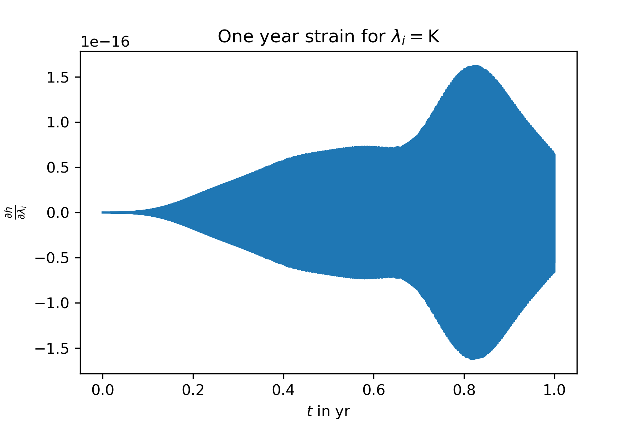
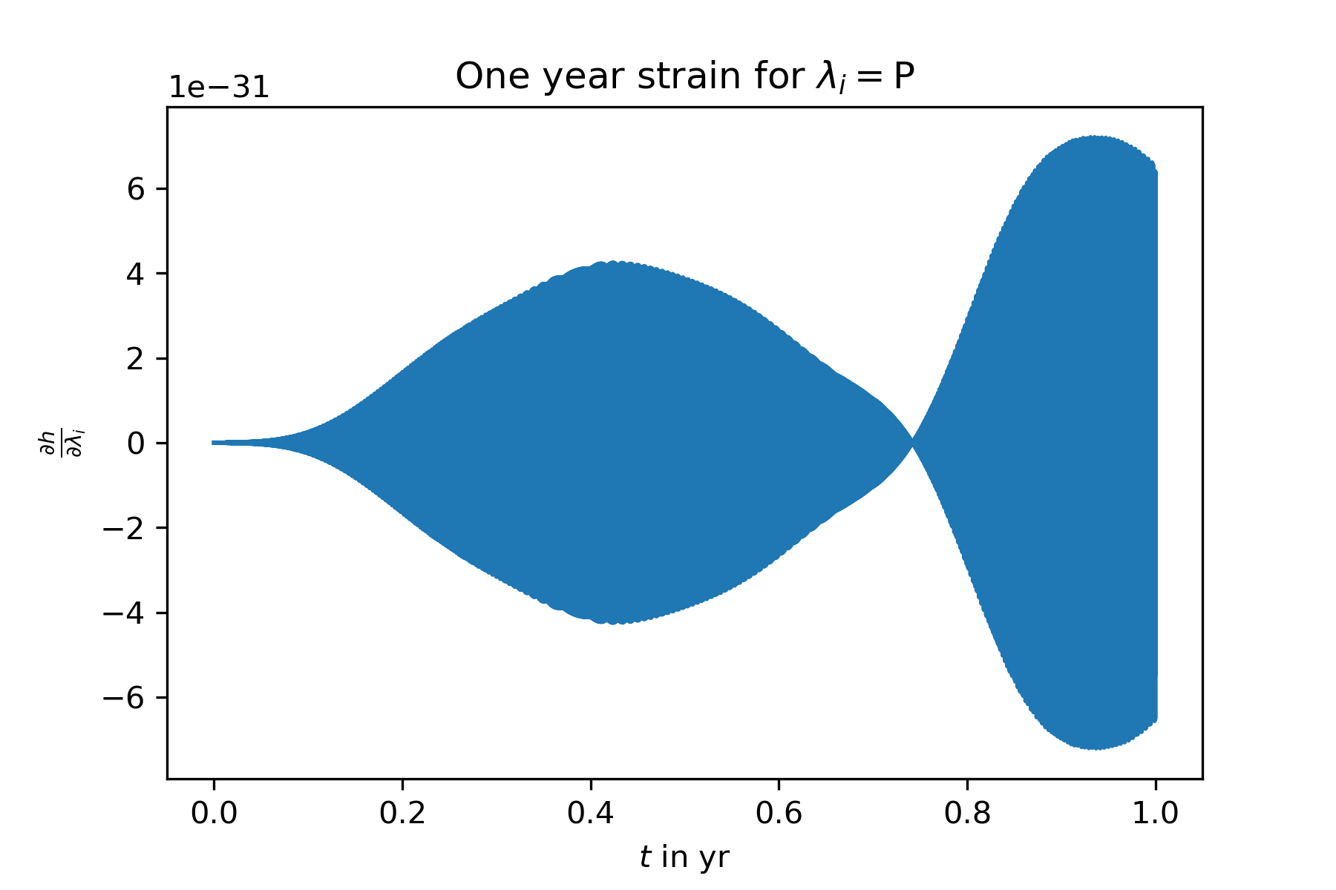
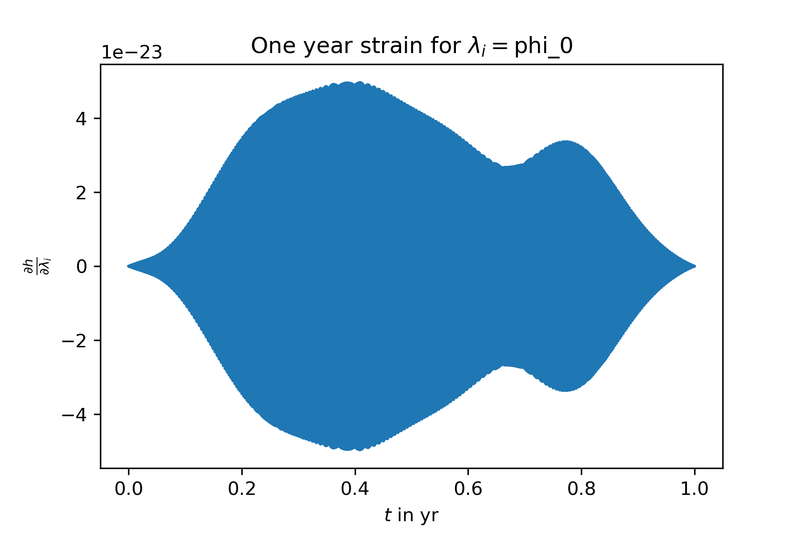
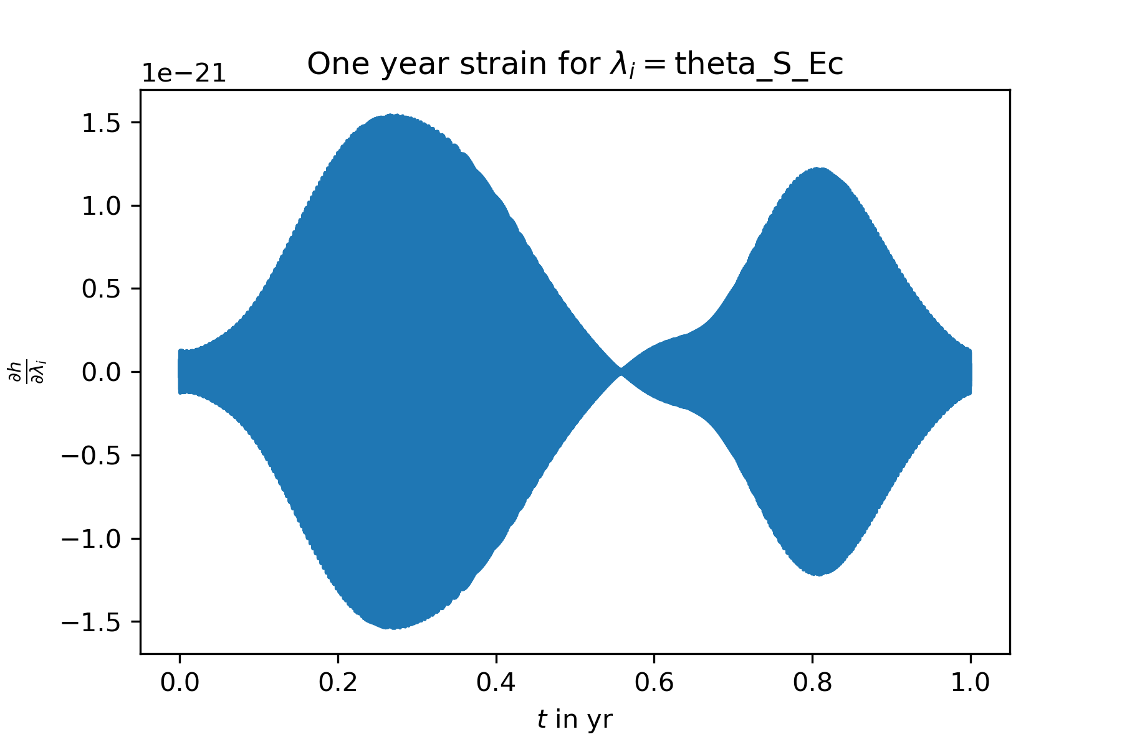
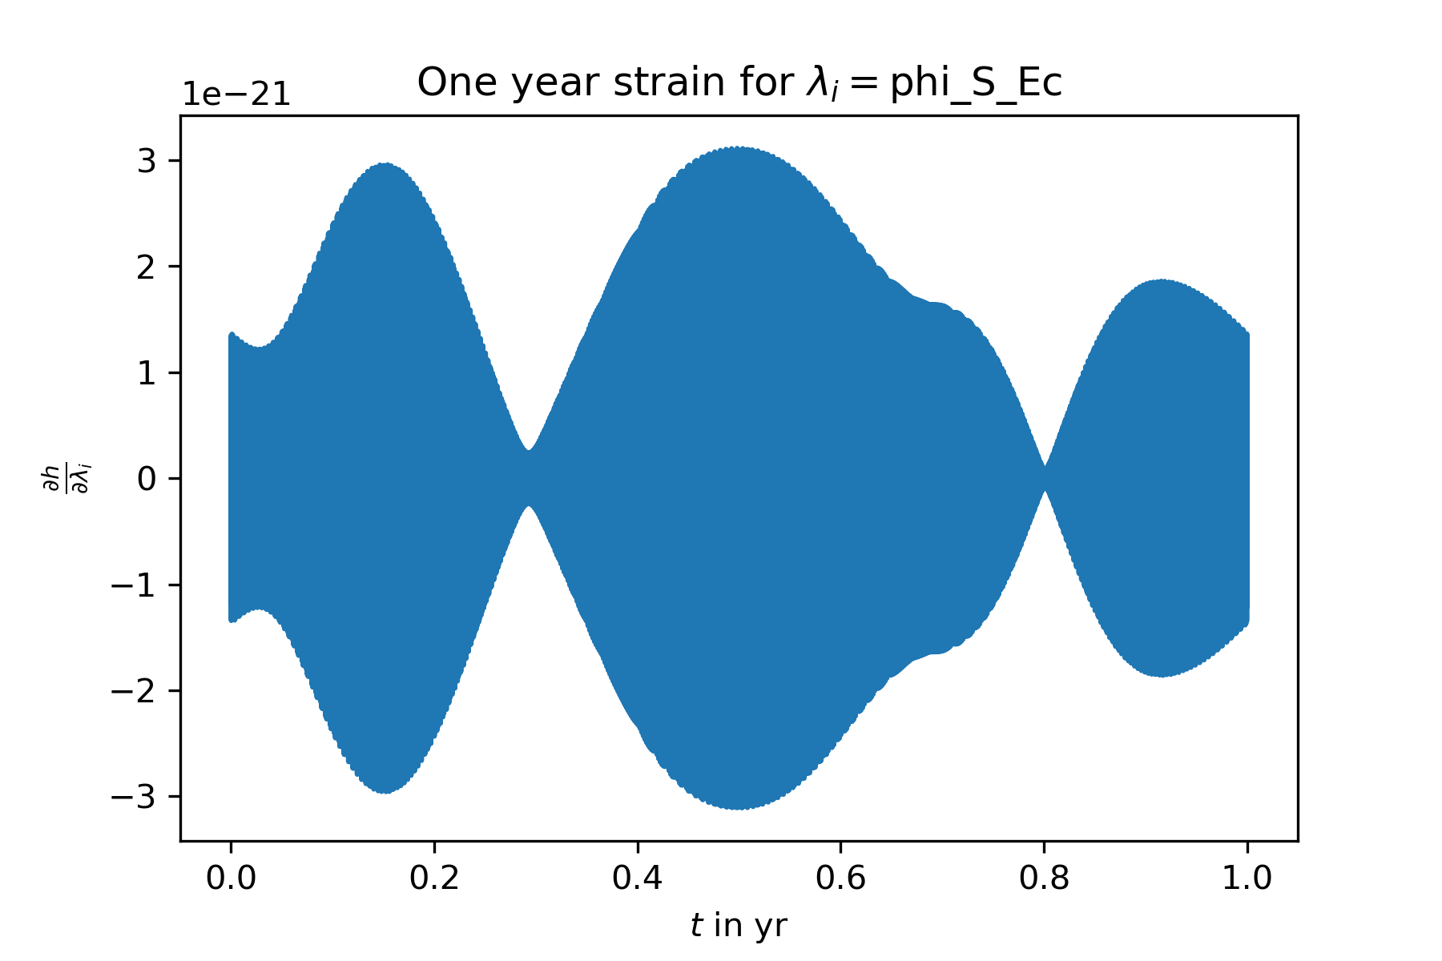
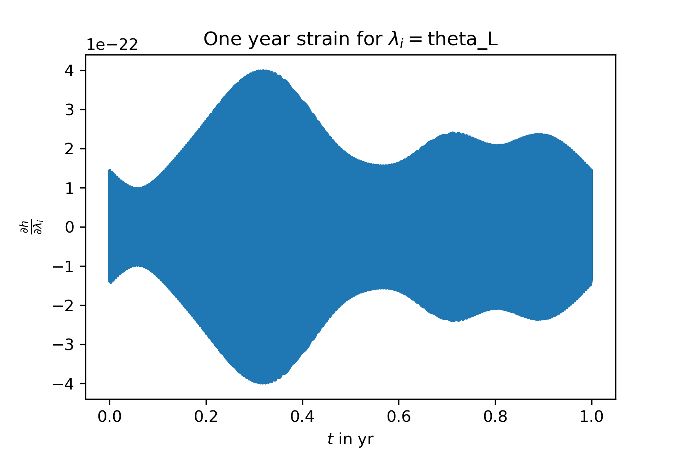
The derivatives $\frac{∂h_{α}}{∂λ_{i}}$ look good, compare the analytic derivatives of the exoplanet par‘s (above) with the numerical derivatives of the position par‘s (below) – same structure: envelope * oscillating function

Slide 4
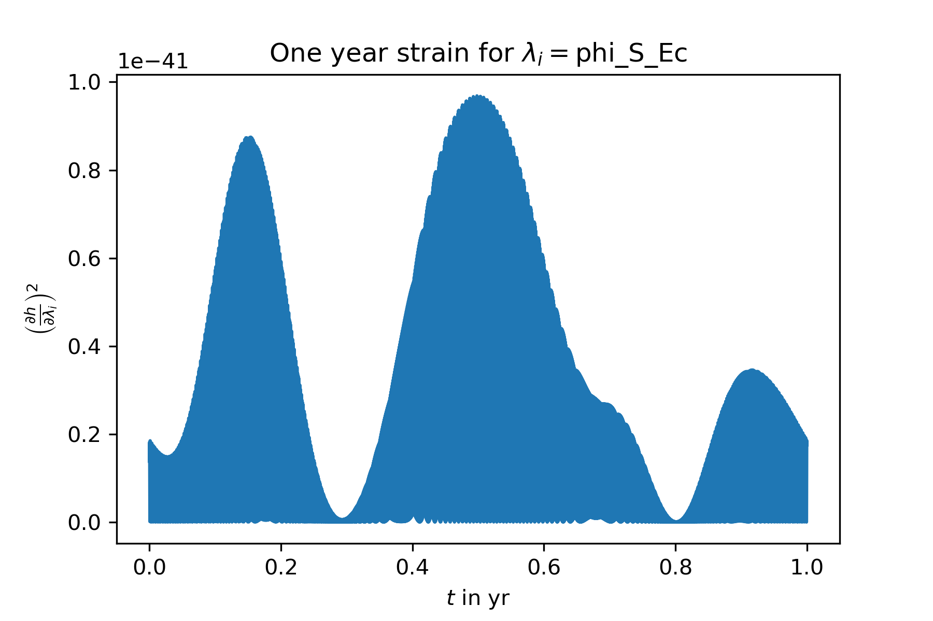
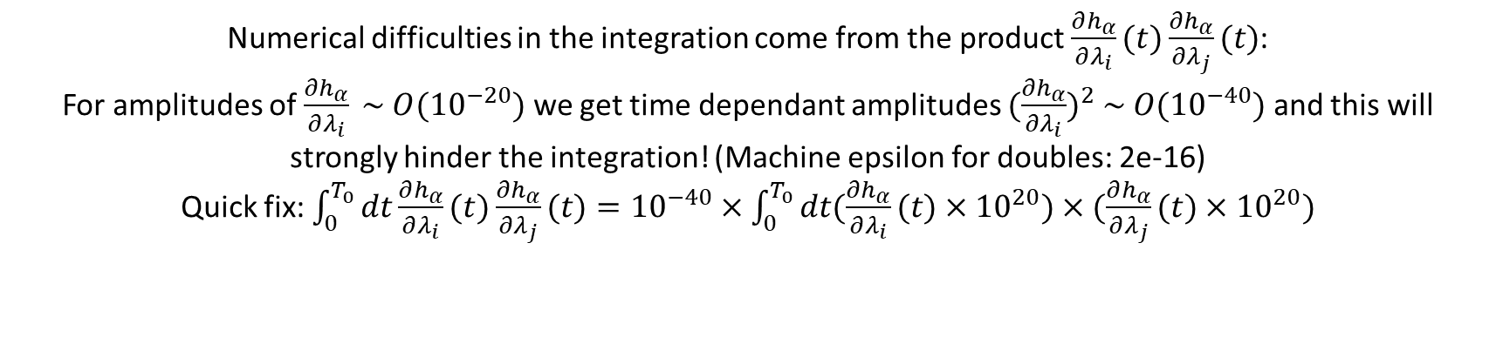
Numerical difficulties in the integration come from the product $\frac{∂h_{α}}{∂λ_{i}}(t)\frac{∂h_{α}}{∂λ_{j}}(t)$:
For amplitudes of $\frac{∂h_{α}}{∂λ_{i}} \sim O({10}^{−20})$ we get time dependant amplitudes ${(\frac{∂h_{α}}{∂λ_{i}})}^{2} \sim O({10}^{−40})$ and this will strongly hinder the integration! (Machine epsilon for doubles: 2e-16)
Quick fix: $\int_{0}^{T_{0}}{dt\frac{∂h_{α}}{∂λ_{i}}(t)\frac{∂h_{α}}{∂λ_{j}}(t)}={10}^{−40}×\int_{0}^{T_{0}}{dt(\frac{∂h_{α}}{∂λ_{i}}(t)×{10}^{20})×(\frac{∂h_{α}}{∂λ_{j}}(t)}×{10}^{20})$

Slide 5
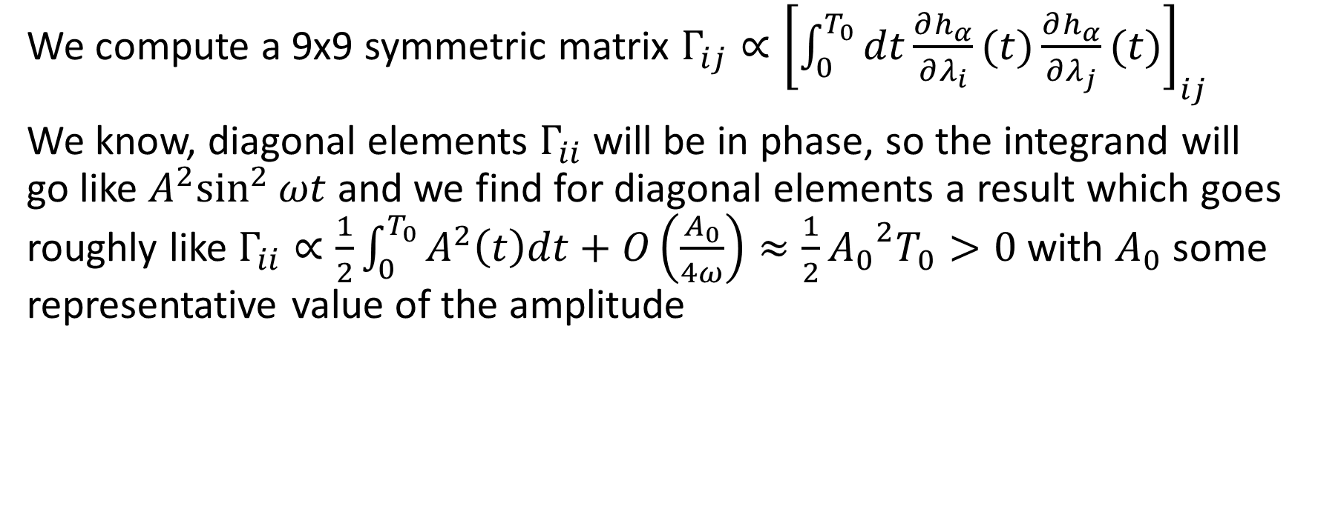
1. Problems in integration
We compute a 9x9 symmetric matrix $Γ_{ij}∝{\left[\int_{0}^{T_{0}}{dt\frac{∂h_{α}}{∂λ_{i}}(t)\frac{∂h_{α}}{∂λ_{j}}(t)}\right]}_{ij}$
We know, diagonal elements $Γ_{ii}$ will be in phase, so the integrand will go like ${A^{2}sin}^{2}{ωt}$ and we find for diagonal elements a result which goes roughly like $Γ_{ii}∝\frac{1}{2}\int_{0}^{T_{0}}{A^{2}\left(t\right)dt}+O\left(\frac{A_{0}}{4ω}\right)≈\frac{1}{2}{A_{0}}^{2}T_{0}>0$ with $A_{0}$ some representative value of the amplitude

Slide 6
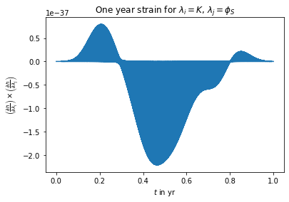
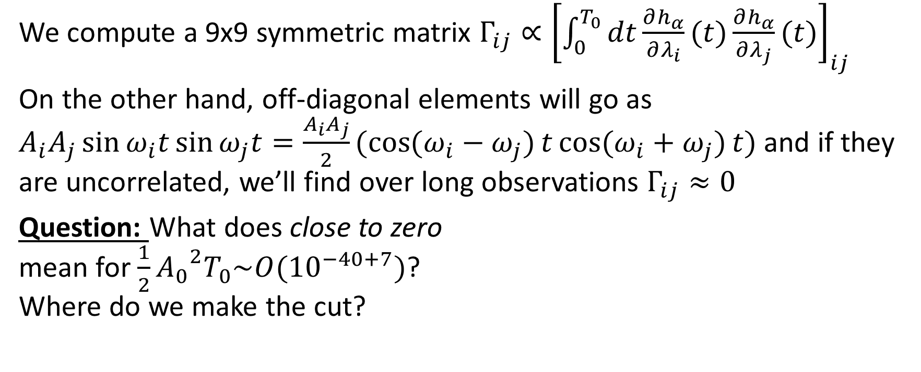
A new problem has approached
We compute a 9x9 symmetric matrix $Γ_{ij}∝{\left[\int_{0}^{T_{0}}{dt\frac{∂h_{α}}{∂λ_{i}}(t)\frac{∂h_{α}}{∂λ_{j}}(t)}\right]}_{ij}$
On the other hand, off-diagonal elements will go as $A_{i}A_{j}\sin{ω_{i}t}\sin{ω_{j}t}=\frac{A_{i}A_{j}}{2}(\cos{(ω_{i}−ω_{j})}t\cos{(ω_{i}+ω_{j})}t)$ and if they are uncorrelated, we’ll find over long observations $Γ_{ij}≈0$
Question: What does close to zero mean for $\frac{1}{2}{A_{0}}^{2}T_{0}\sim O({10}^{−40+7})$? Where do we make the cut?

Slide 7
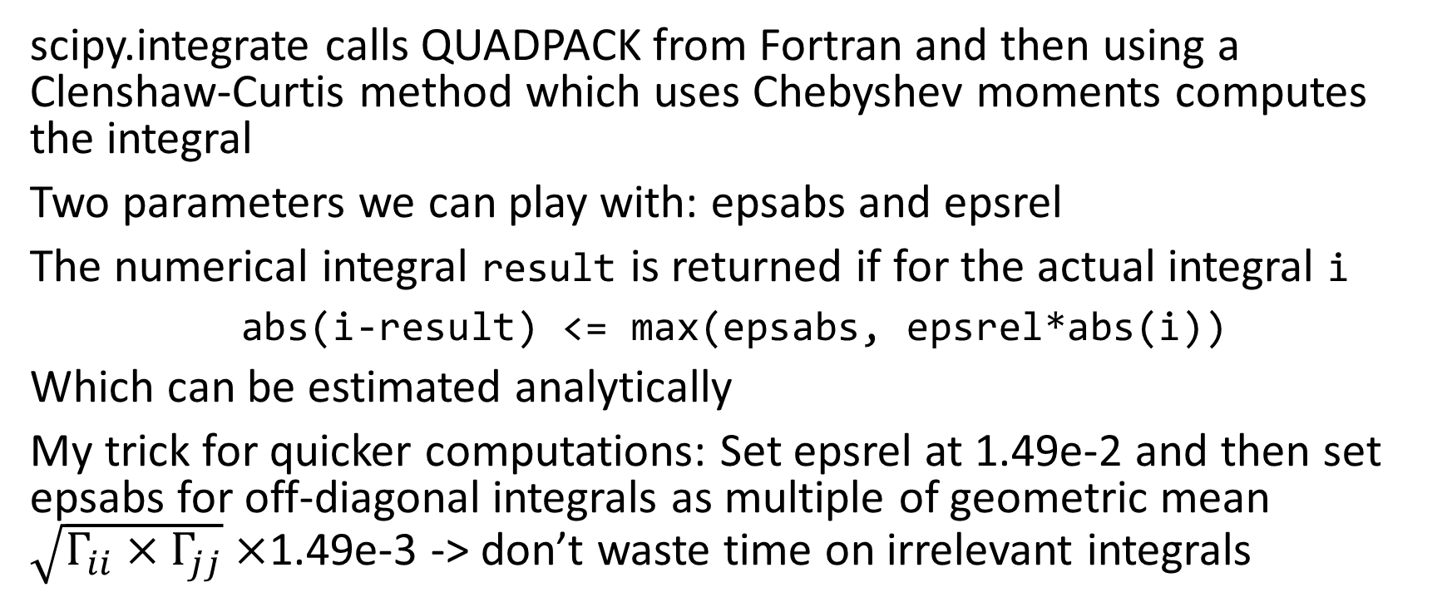
A short recap on numerical integration
scipy.integrate calls QUADPACK from Fortran and then using a Clenshaw-Curtis method which uses Chebyshev moments computes the integral
Two parameters we can play with: epsabs and epsrel
The numerical integral result is returned if for the actual integral i
abs(i-result) <= max(epsabs, epsrel*abs(i))
Which can be estimated analytically
My trick for quicker computations: Set epsrel at 1.49e-2 and then set epsabs for off-diagonal integrals as multiple of geometric mean $\sqrt{Γ_{ii}×Γ_{jj}}×$1.49e-3 -> don’t waste time on irrelevant integrals

Slide 8
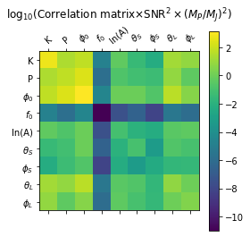
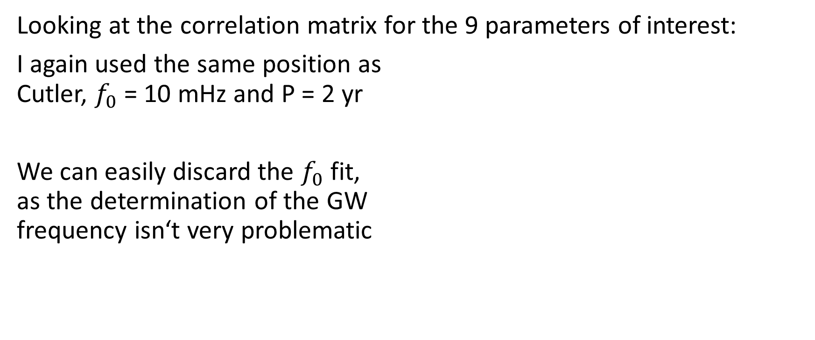
Findings
Looking at the correlation matrix for the 9 parameters of interest:
I again used the same position as Cutler, $f_{0}$ = 10 mHz and P = 2 yr
We can easily discard the $f_{0}$fit, as the determination of the GW frequency isn‘t very problematic

Slide 9
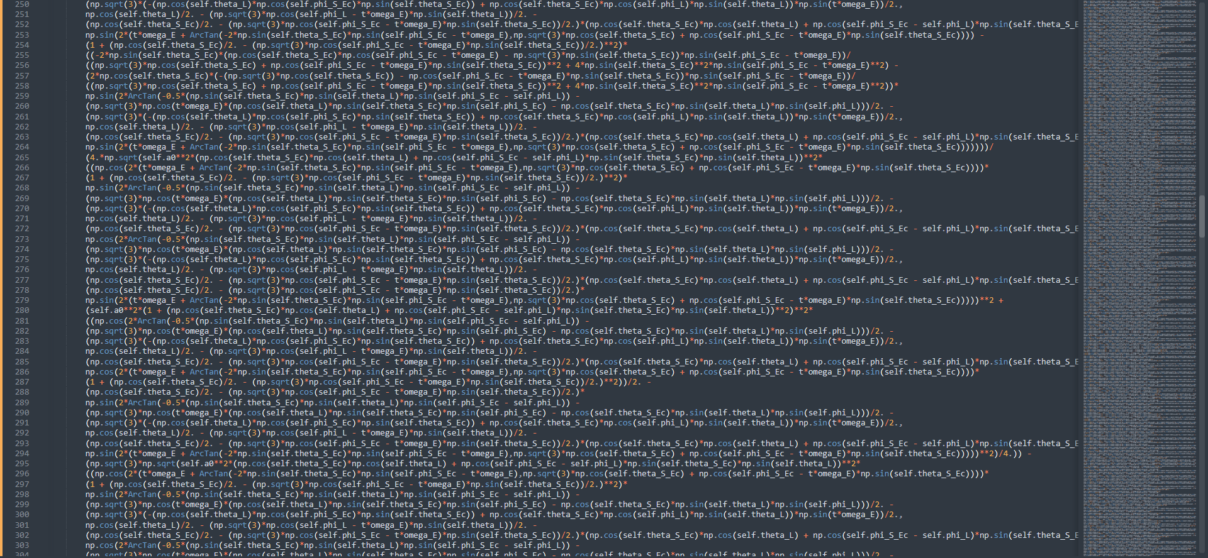
Note that the analytic derivative does exist, but it is a) too long for pretty code – you see a snippet of the 657 lines of terms for $\frac{∂h_{α}}{∂θ_{S}}(t)$ in python code, see delh_delthetaS.txt on Git and…

Slide 10
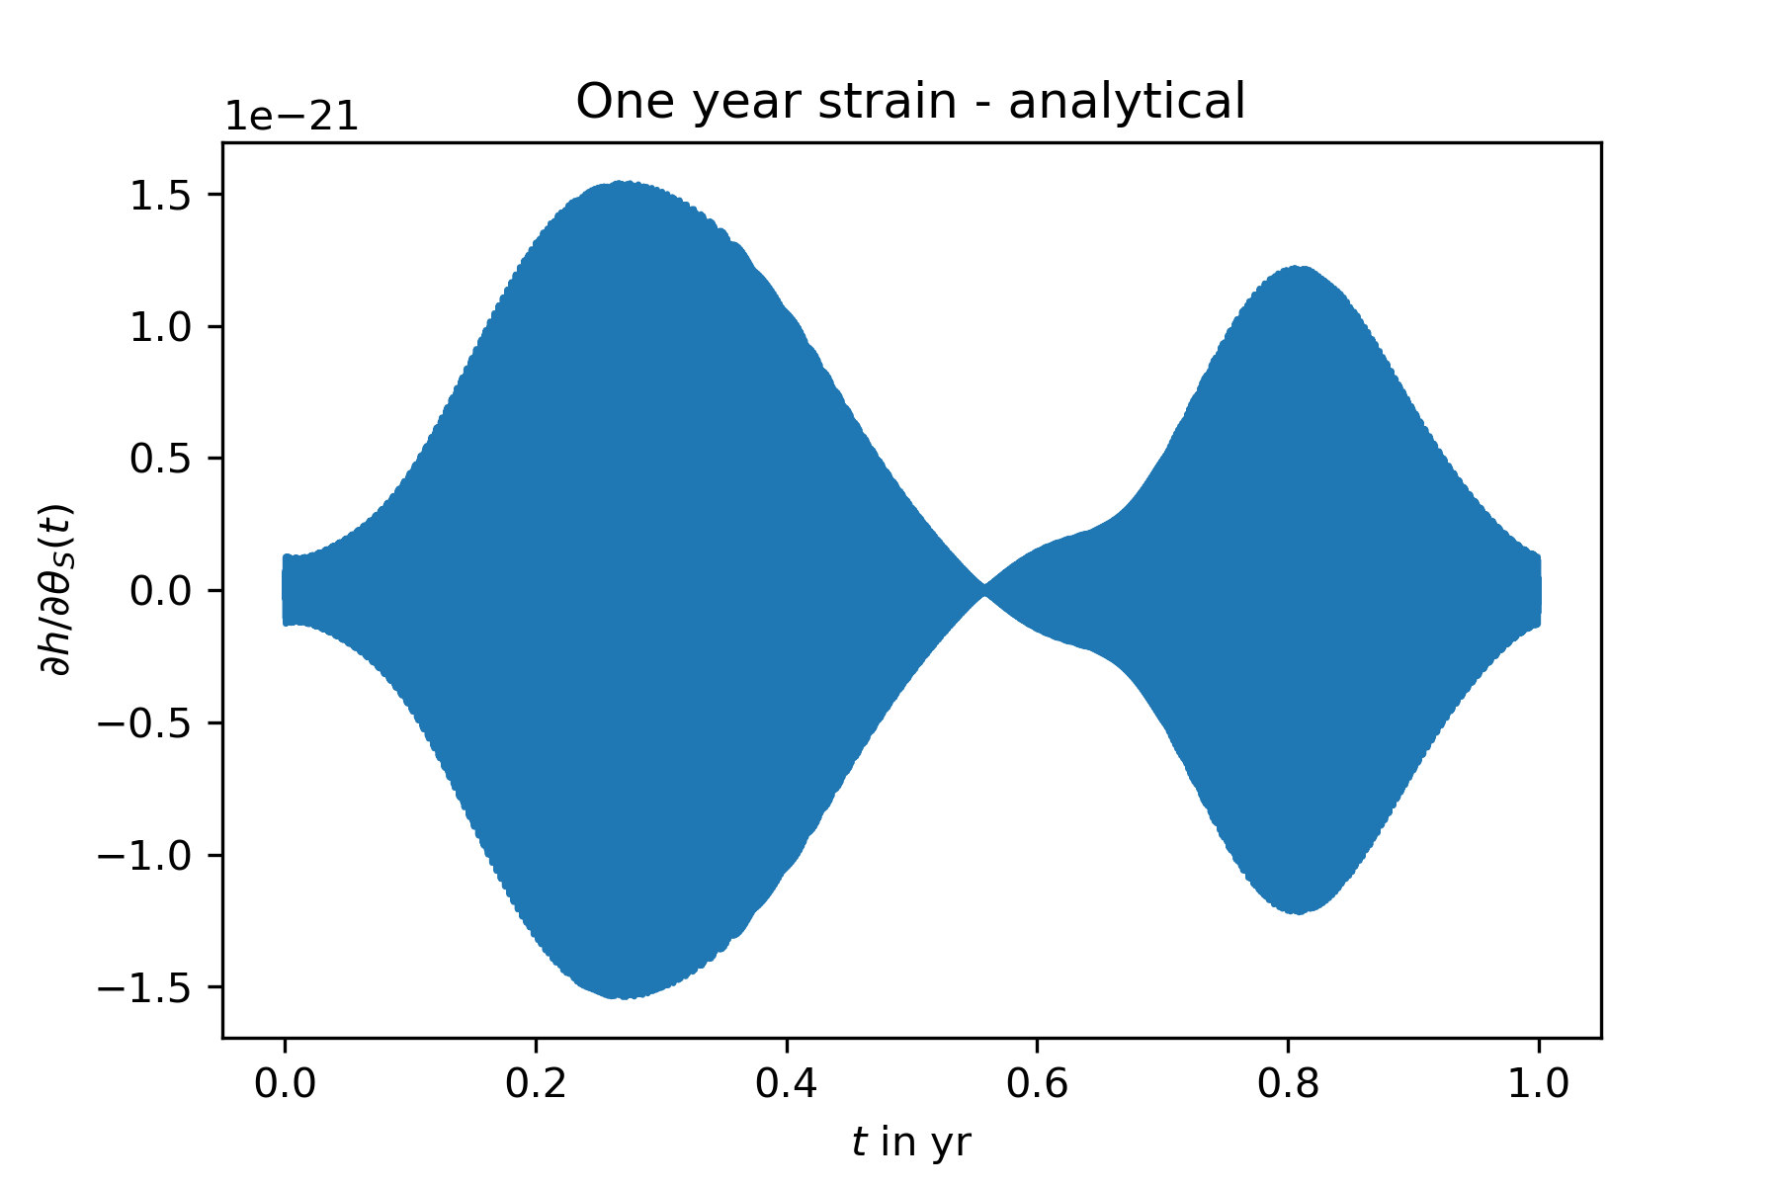
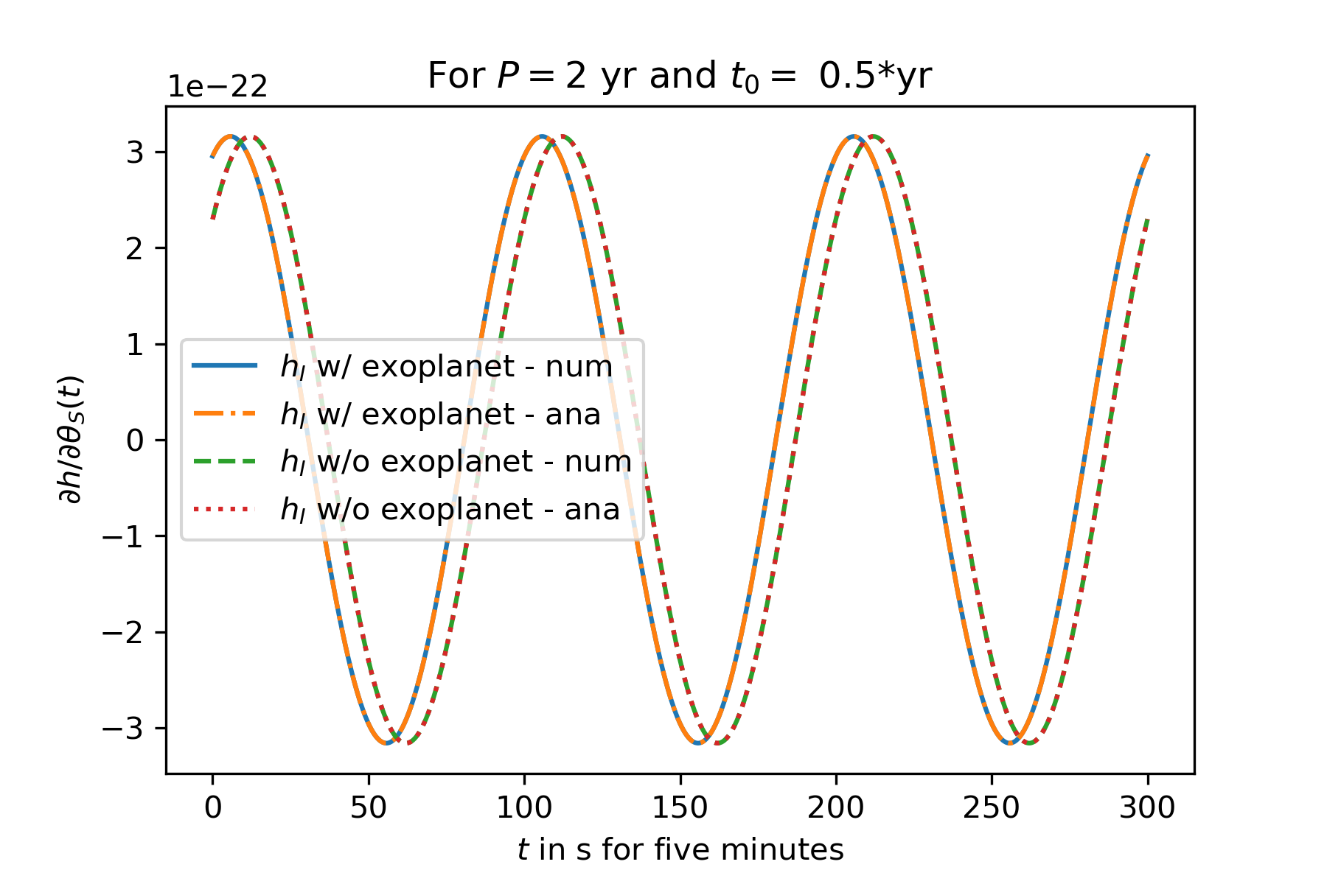
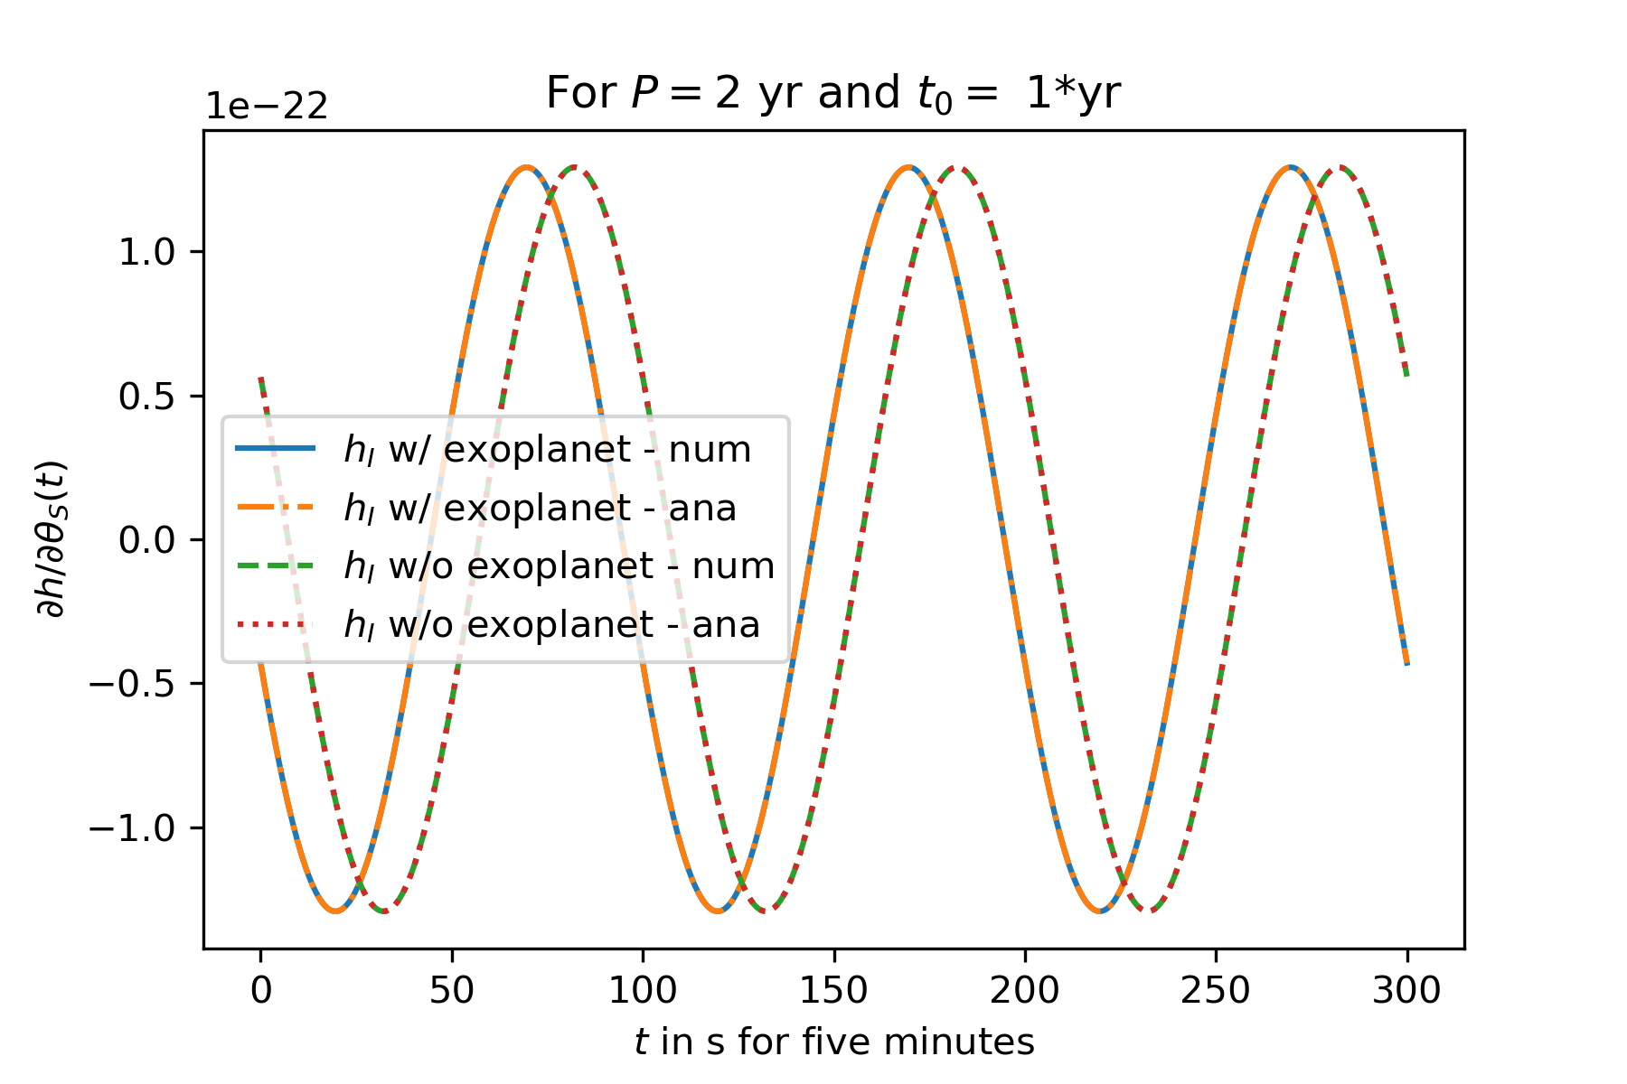
 | Numerical derivative | Analytic derivative
Shape of the Amplitude
Shape of the frequency (1 hour after 0.3*yr)
b) results in the same function anyways, though the analytic one takes longer to compute, plus…

Slide 11
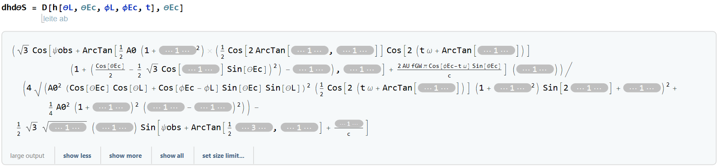
And sadly life would be too easy if we could integrate it analytically :c
c) neither Simplify nor Integrate will return

Slide 12
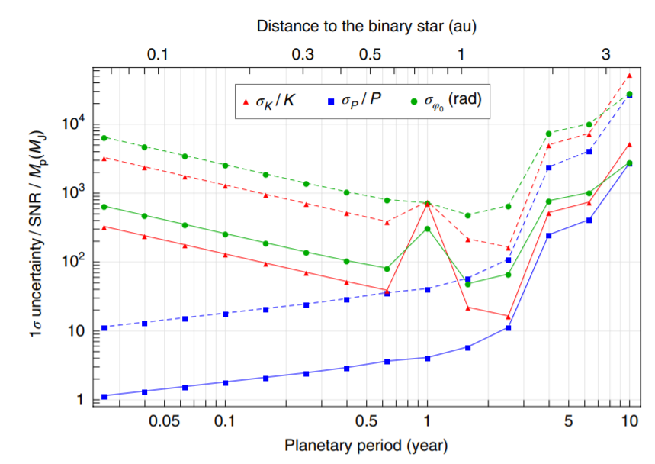
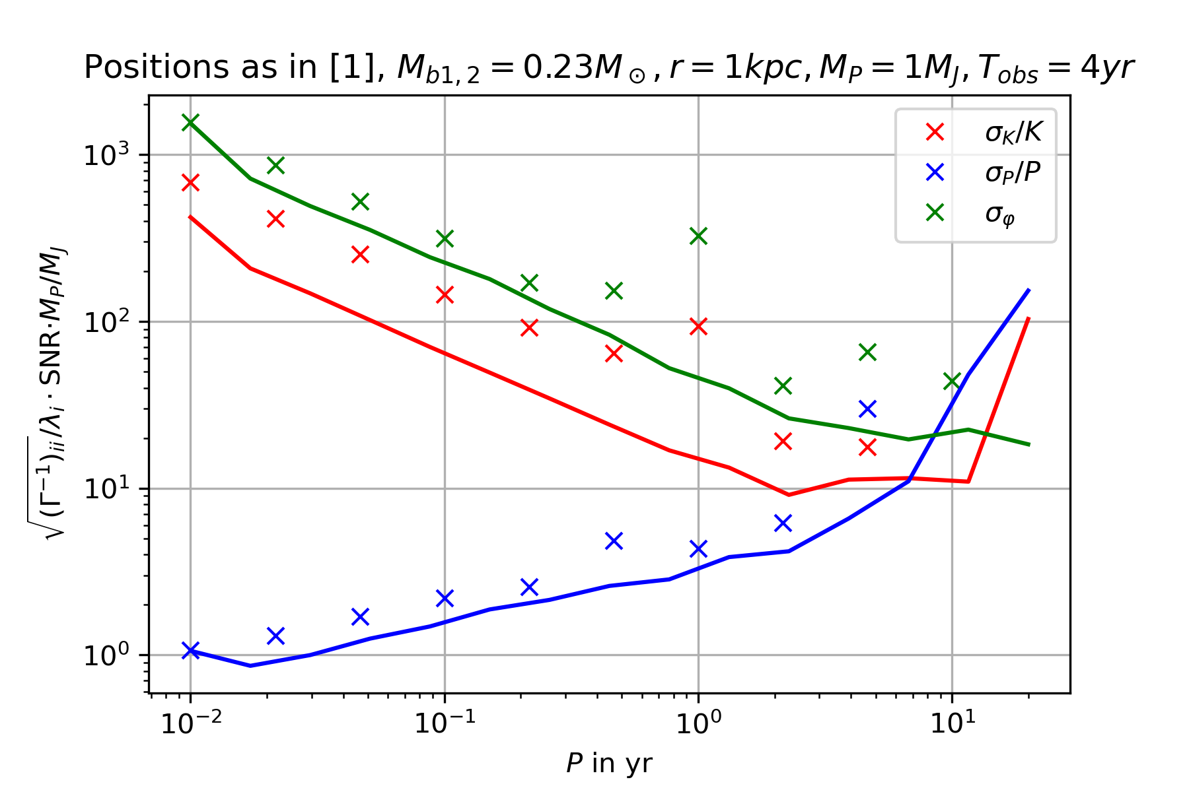
3. Result for LISA
Sadly it still doesn‘t work, even with higher precision in integration… crosses are big 9x9 Fisher matrices, straight lines small 3x3 Fisher matrices
At this point I‘m finally going to stop though – only difference to Tamanini: At some point I stopped doing the integration with all three arms, but did it only with two arms and rescaled the Fisher matrix and SNR^2 by 2

Slide 13
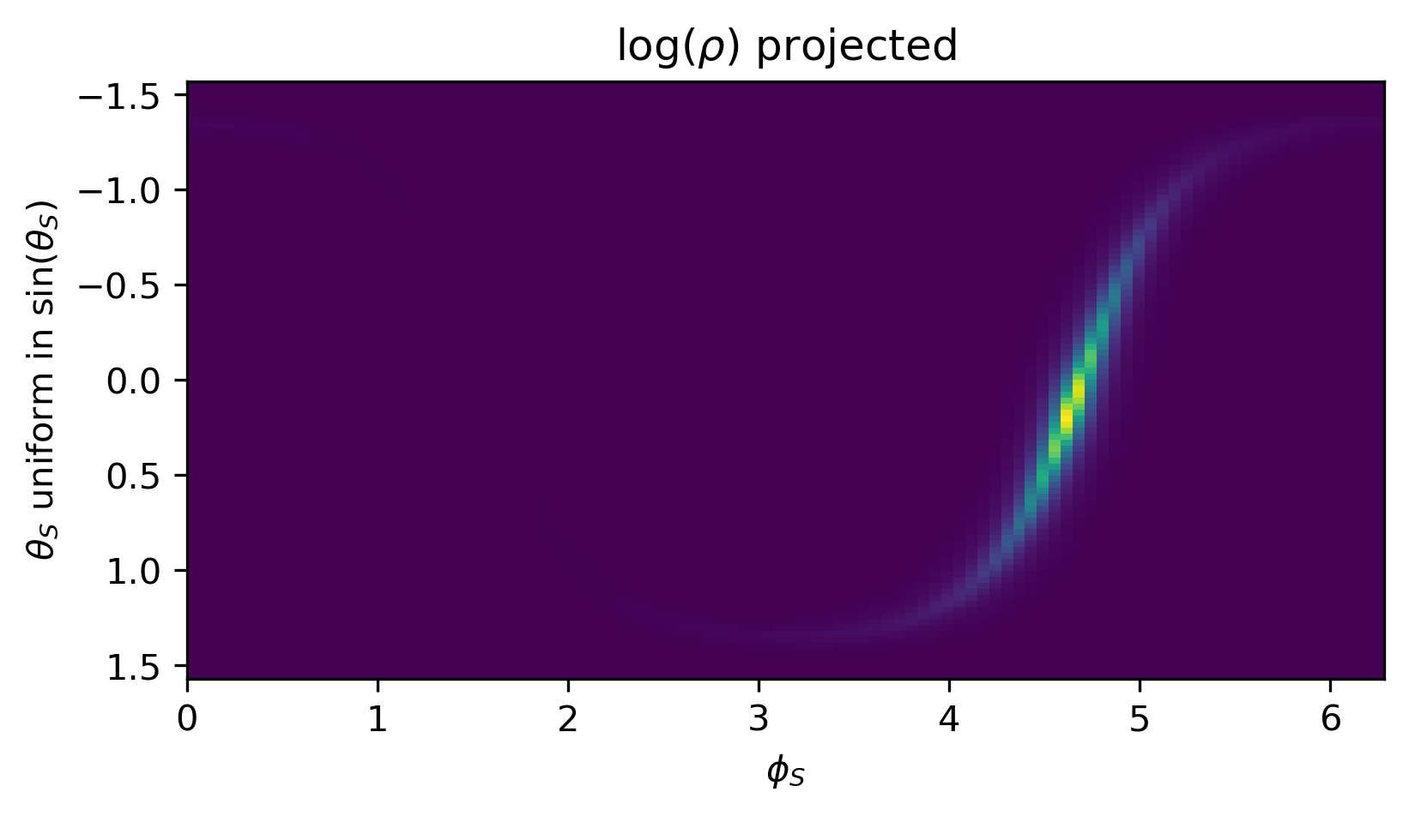
How will the position be a factor for the uncertainty?
Look for a change in uncertainties over relevant region in milky way
x
x
x
x
x

Slide 14
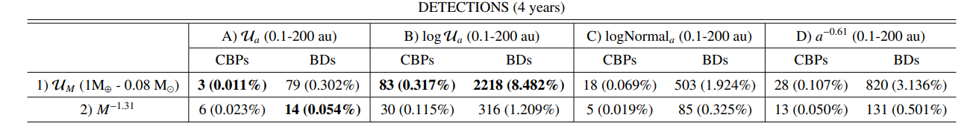
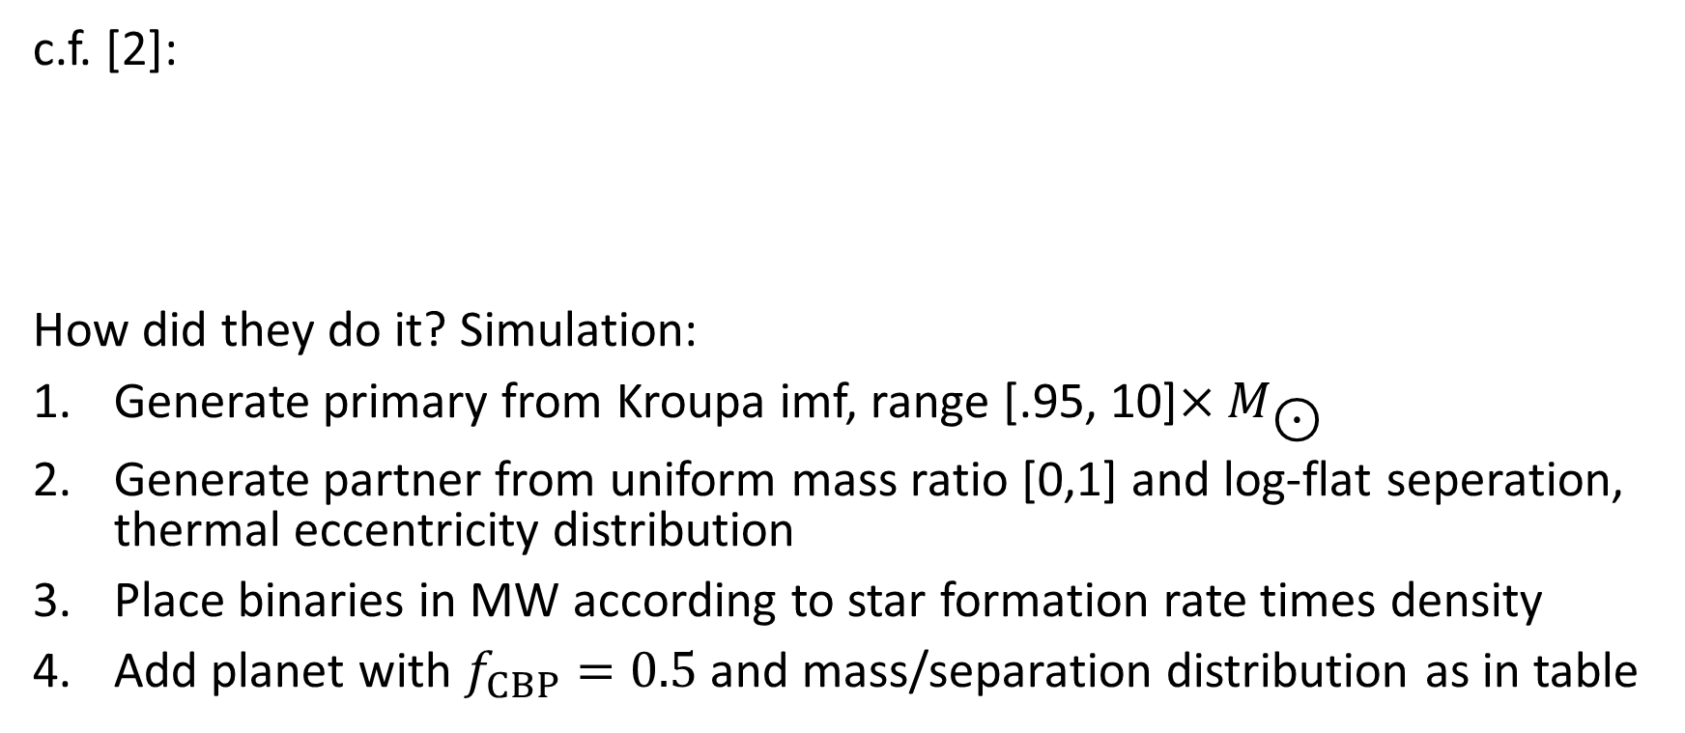
4. Regards on exoplanet constraints in Milky Way
c.f. [2]:
How did they do it? Simulation:
Generate primary from Kroupa imf, range [.95, 10]${×M}_{\text{⊙}}$
Generate partner from uniform mass ratio [0,1] and log-flat seperation, thermal eccentricity distribution
Place binaries in MW according to star formation rate times density
Add planet with $f_{CBP}=0.5$ and mass/separation distribution as in table

Slide 15
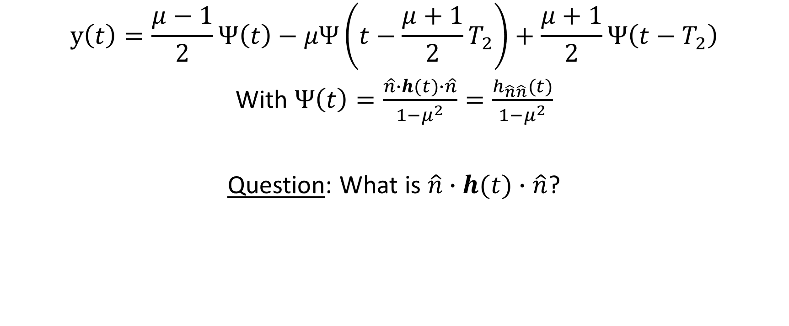
5. IceGiant mission
$$y\left(t\right)=\frac{μ−1}{2}Ψ\left(t\right)−μΨ\left(t−\frac{μ+1}{2}T_{2}\right)+\frac{μ+1}{2}Ψ\left(t−T_{2}\right)$$
With $Ψ\left(t\right)=\frac{\hat{n}∙h(t)∙\hat{n}}{1−μ^{2}}=\frac{h_{\hat{n}\hat{n}}(t)}{1−μ^{2}}$
Question: What is $\hat{n}∙h(t)∙\hat{n}$?

Slide 16
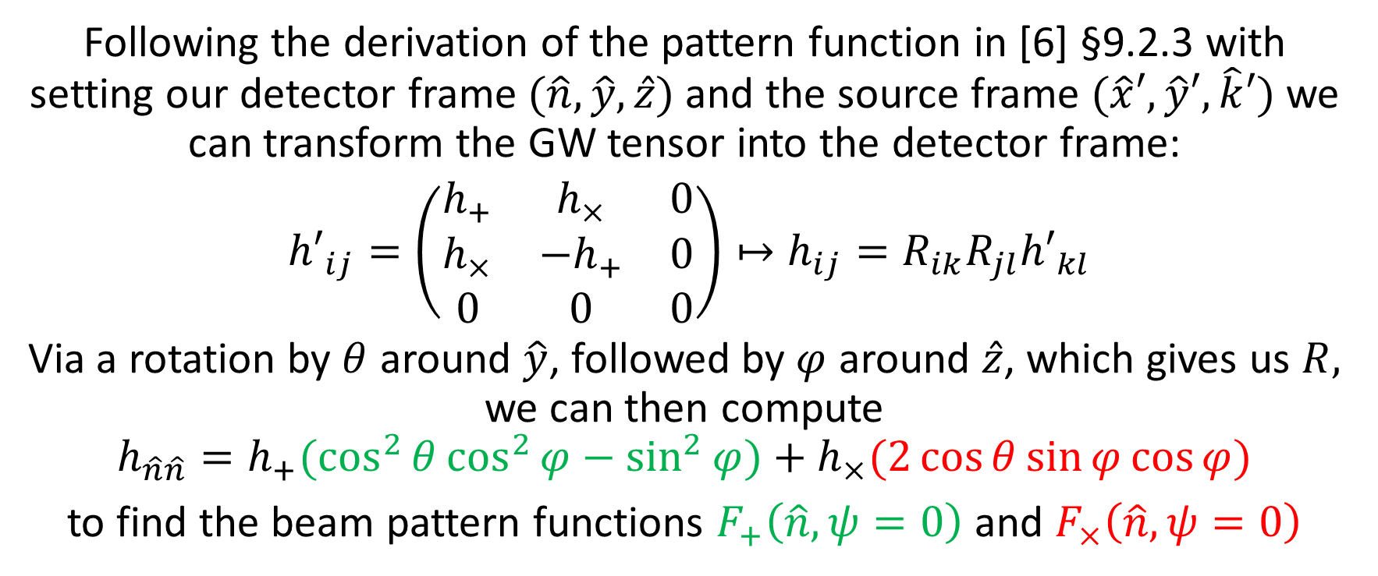
How well will icegiant constrain exoplanets?
Following the derivation of the pattern function in [6] §9.2.3 with setting our detector frame $(\hat{n},\hat{y},\hat{z})$ and the source frame $(\hat{x}′,\hat{y}′,\hat{k}′)$ we can transform the GW tensor into the detector frame:
${h′}_{ij}=\left(\begin{matrix}h_{+} & h_{×} & 0 \\ h_{×} & −h_{+} & 0 \\ 0 & 0 & 0\end{matrix}\right)↦h_{ij}=R_{ik}R_{jl}{h′}_{kl}$
Via a rotation by $θ$ around $\hat{y}$, followed by $φ$ around $\hat{z}$, which gives us $R,$ we can then compute
$$h_{\hat{n}\hat{n}}=h_{+}(\cos^{2}{θ}\cos^{2}{φ}−\sin^{2}{φ})+h_{×}(2\cos{θ}\sin{φ}\cos{φ})$$
to find the beam pattern functions $F_{+}\left(\hat{n},ψ=0\right)$ and $F_{×}\left(\hat{n},ψ=0\right)$

Slide 17
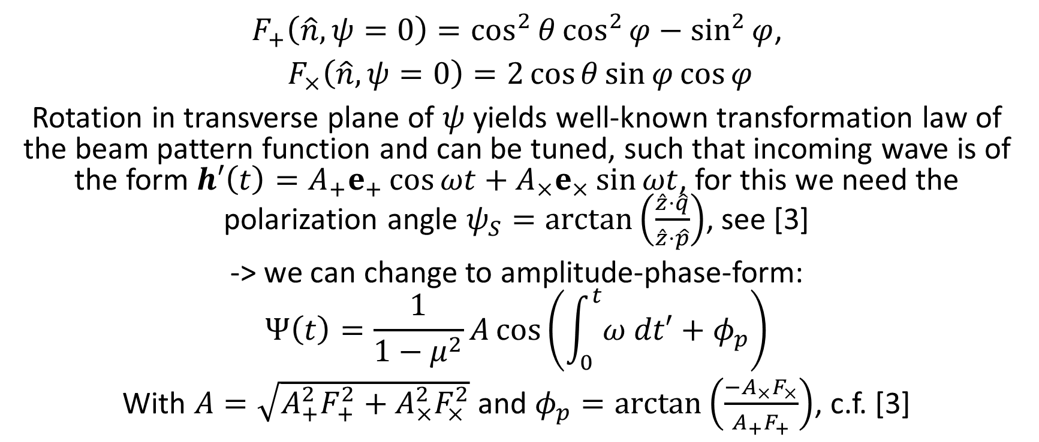
How well will icegiant constrain exoplanets?
$F_{+}\left(\hat{n},ψ=0\right)=\cos^{2}{θ}\cos^{2}{φ}−\sin^{2}{φ}$,
$F_{×}\left(\hat{n},ψ=0\right)=2\cos{θ}\sin{φ}\cos{φ}$
Rotation in transverse plane of $ψ$ yields well-known transformation law of the beam pattern function and can be tuned, such that incoming wave is of the form $h′\left(t\right)=A_{+}e_{+}\cos{ωt}+A_{×}e_{×}\sin{ωt}$, for this we need the polarization angle $ψ_{S}=arctan⁡\left(\frac{\hat{z}⋅\hat{q}}{\hat{z}⋅\hat{p}}\right)$, see [3]
-> we can change to amplitude-phase-form:
$$Ψ\left(t\right)=\frac{1}{1−μ^{2}}A\cos\left(\int_{0}^{t}{ω dt′}+φ_{p}\right)$$
With $A=\sqrt{A_{+}^{2}F_{+}^{2}+A_{×}^{2}F_{×}^{2}}$ and $φ_{p}=arctan\left(\frac{−A_{×}F_{×}}{A_{+}F_{+}}\right)$, c.f. [3]

Slide 18
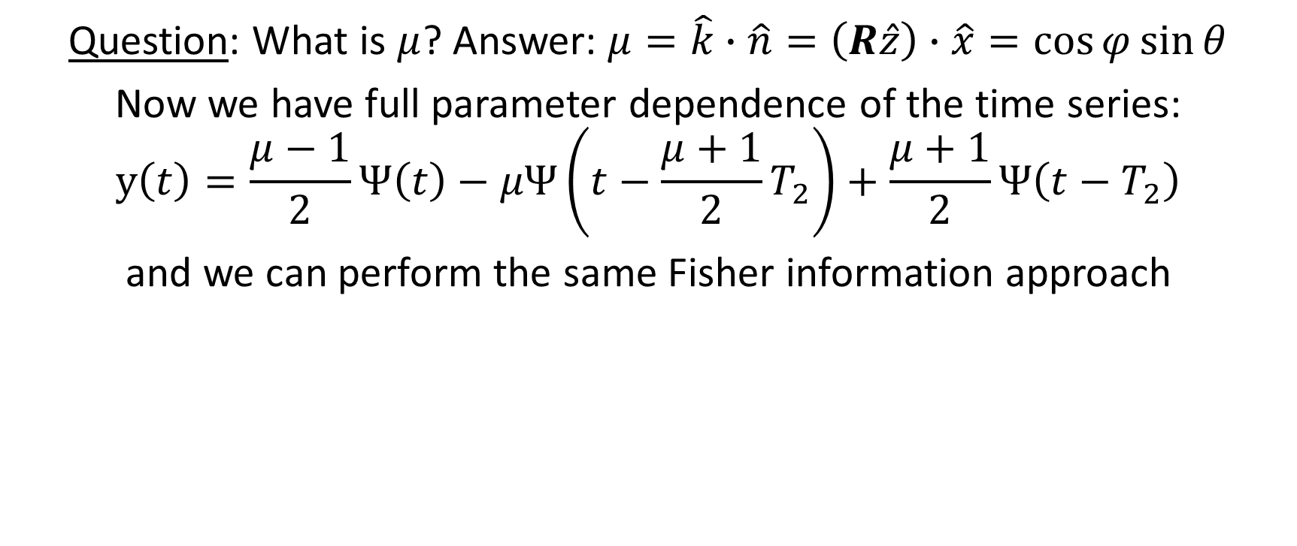
How well will icegiant constrain exoplanets?
Question: What is $μ$? Answer: $μ=\hat{k}∙\hat{n}=\left(R\hat{z}\right)∙\hat{x}=\cos{φ}\sin{θ}$
Now we have full parameter dependence of the time series:
$$y\left(t\right)=\frac{μ−1}{2}Ψ\left(t\right)−μΨ\left(t−\frac{μ+1}{2}T_{2}\right)+\frac{μ+1}{2}Ψ\left(t−T_{2}\right)$$
and we can perform the same Fisher information approach

Slide 19
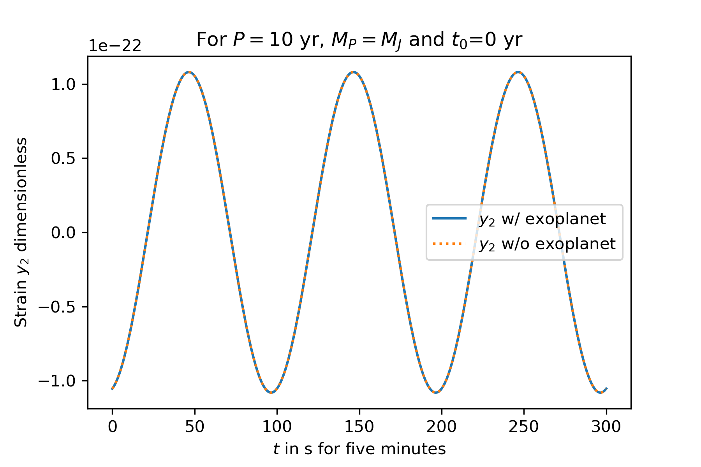
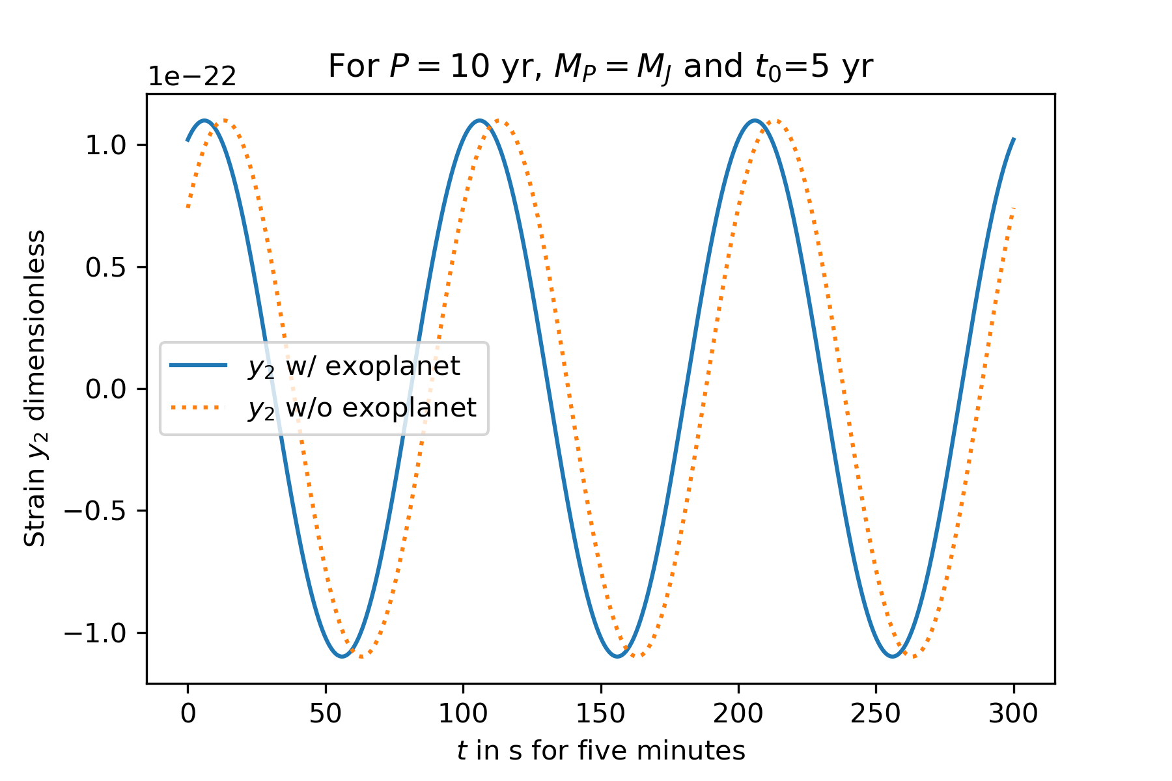
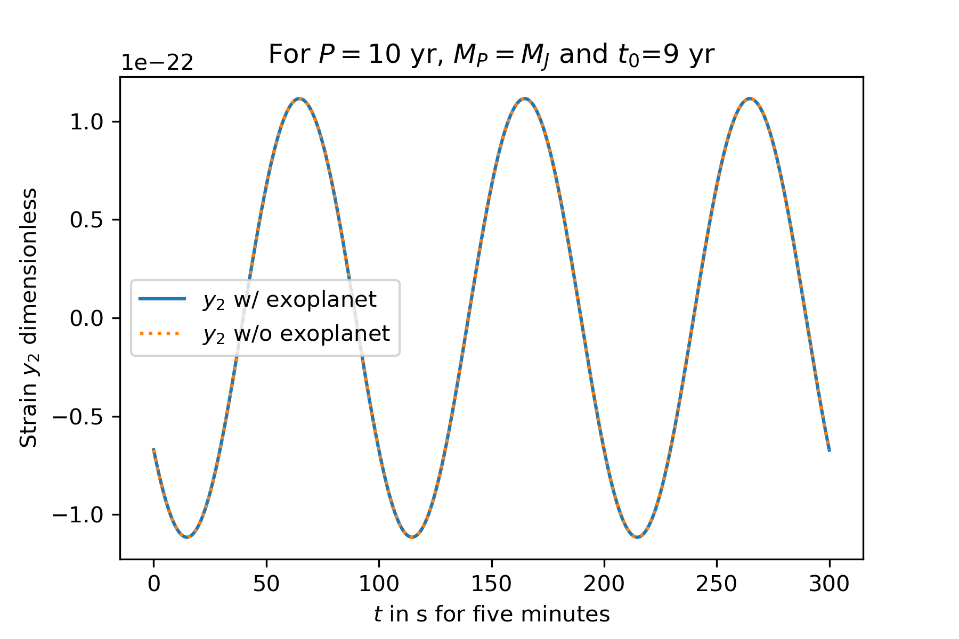
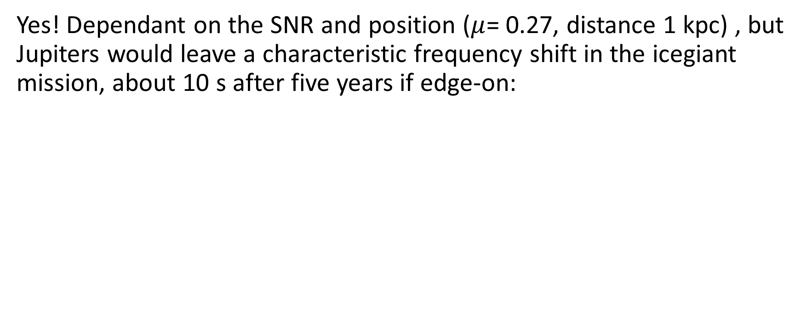
But would icegiant see Jupiters?
Yes! Dependant on the SNR and position ($μ$= 0.27, distance 1 kpc) , but Jupiters would leave a characteristic frequency shift in the icegiant mission, about 10 s after five years if edge-on:

Slide 20
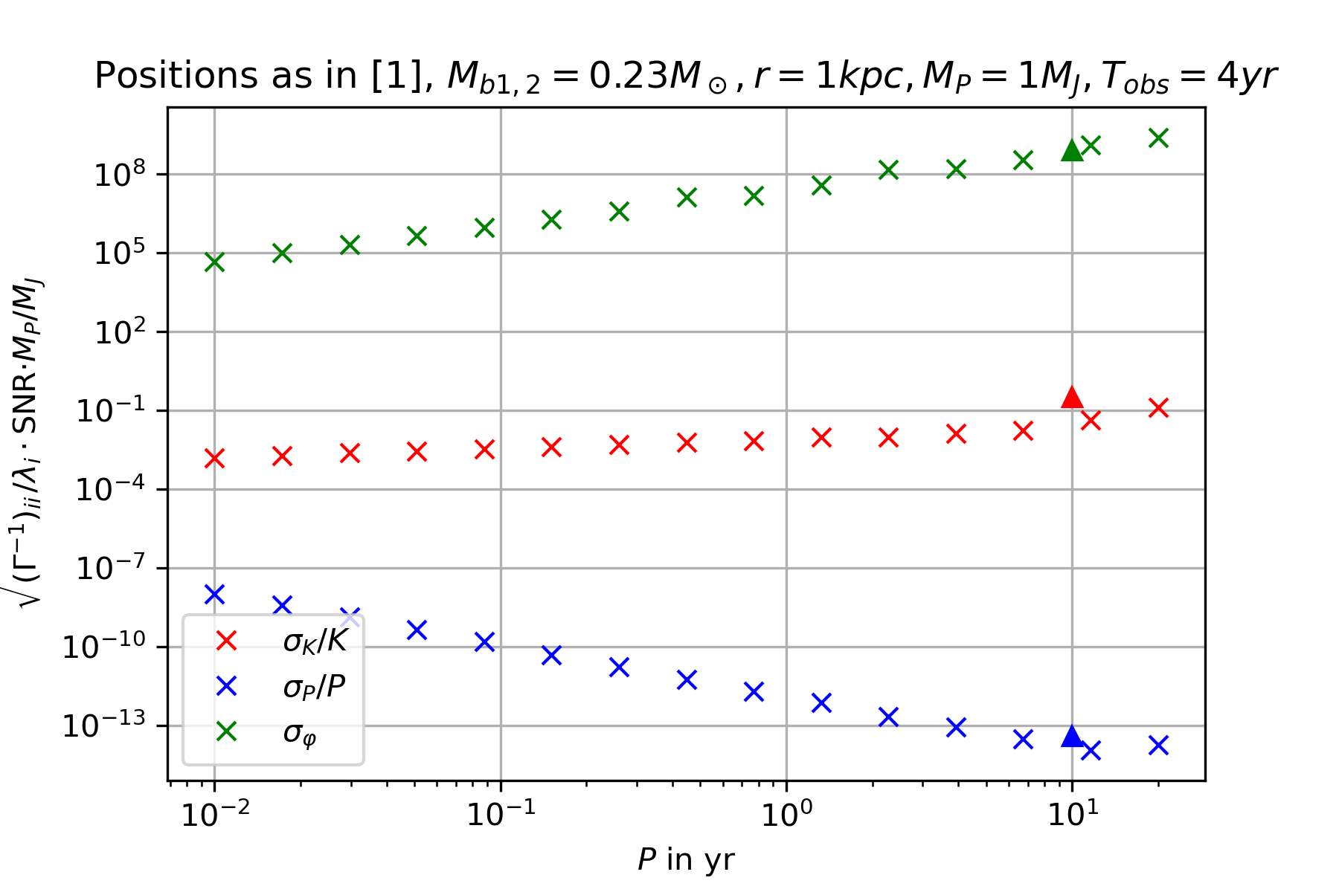
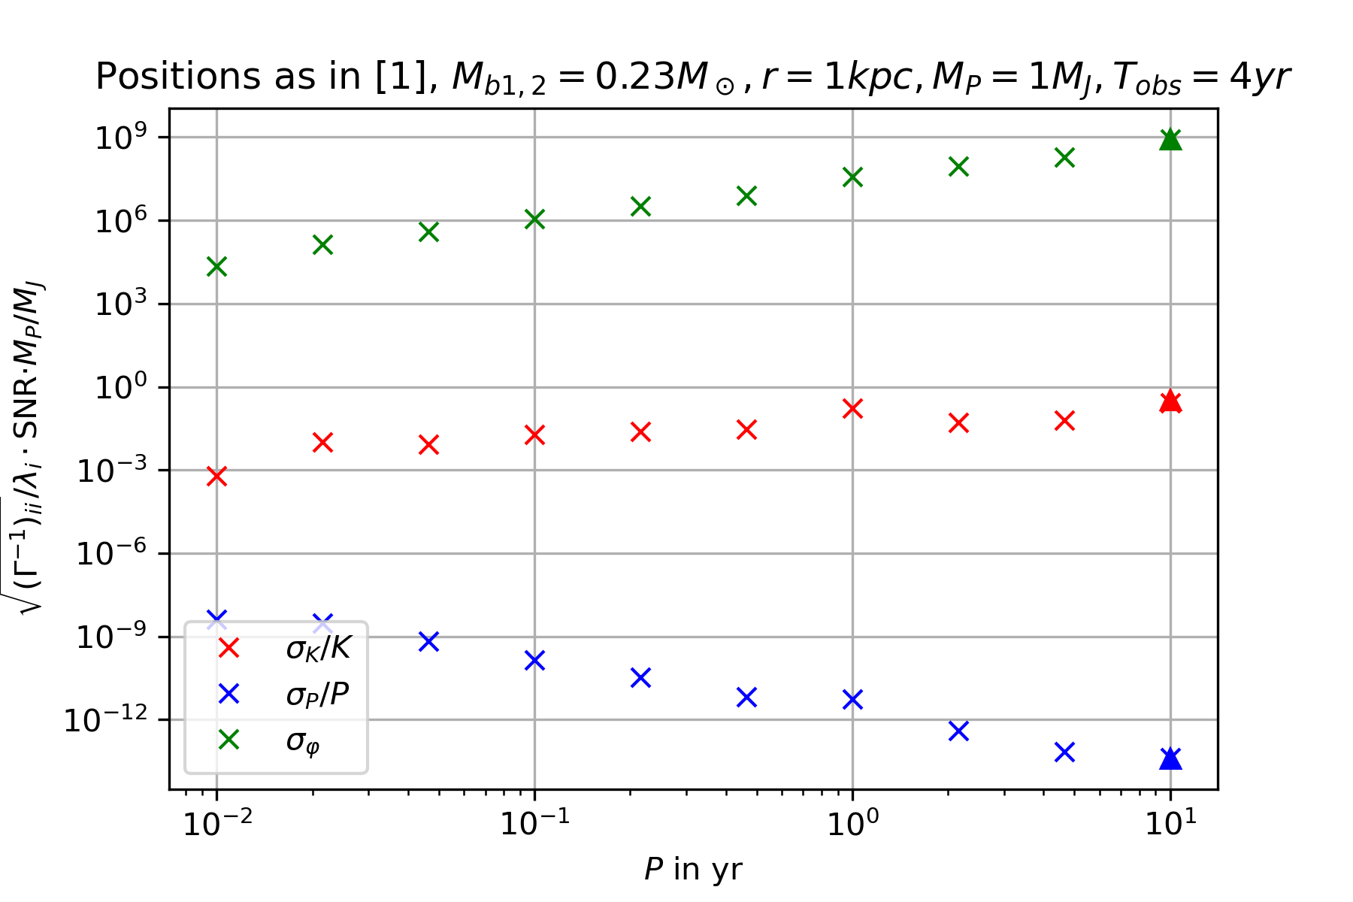
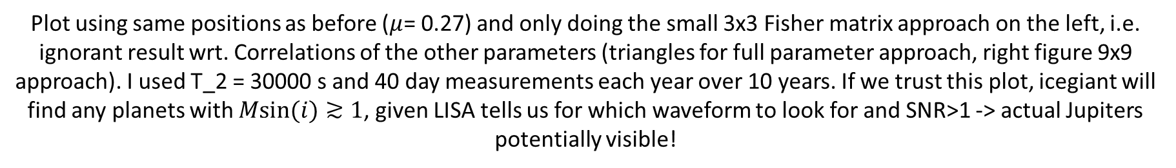
How well will icegiant constrain exoplanets?
Plot using same positions as before ($μ$= 0.27) and only doing the small 3x3 Fisher matrix approach on the left, i.e. ignorant result wrt. Correlations of the other parameters (triangles for full parameter approach, right figure 9x9 approach). I used T_2 = 30000 s and 40 day measurements each year over 10 years. If we trust this plot, icegiant will find any planets with $Msin(i)≳1$, given LISA tells us for which waveform to look for and SNR>1 -> actual Jupiters potentially visible!

Slide 21
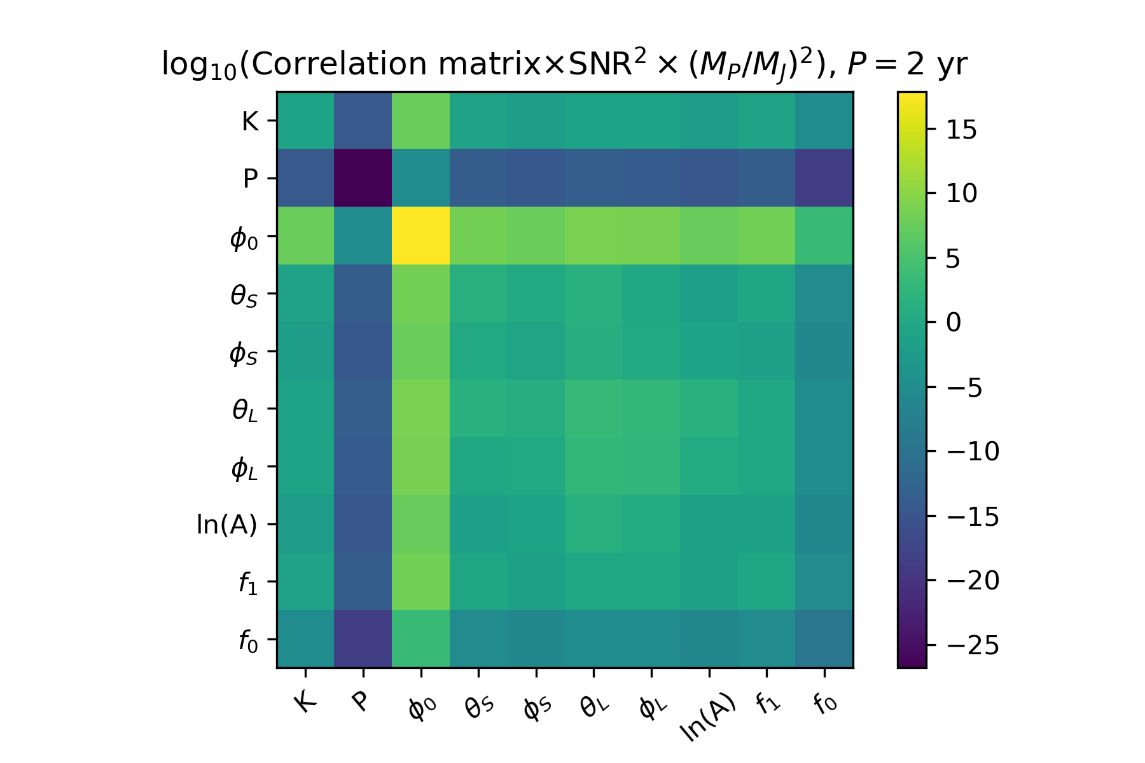
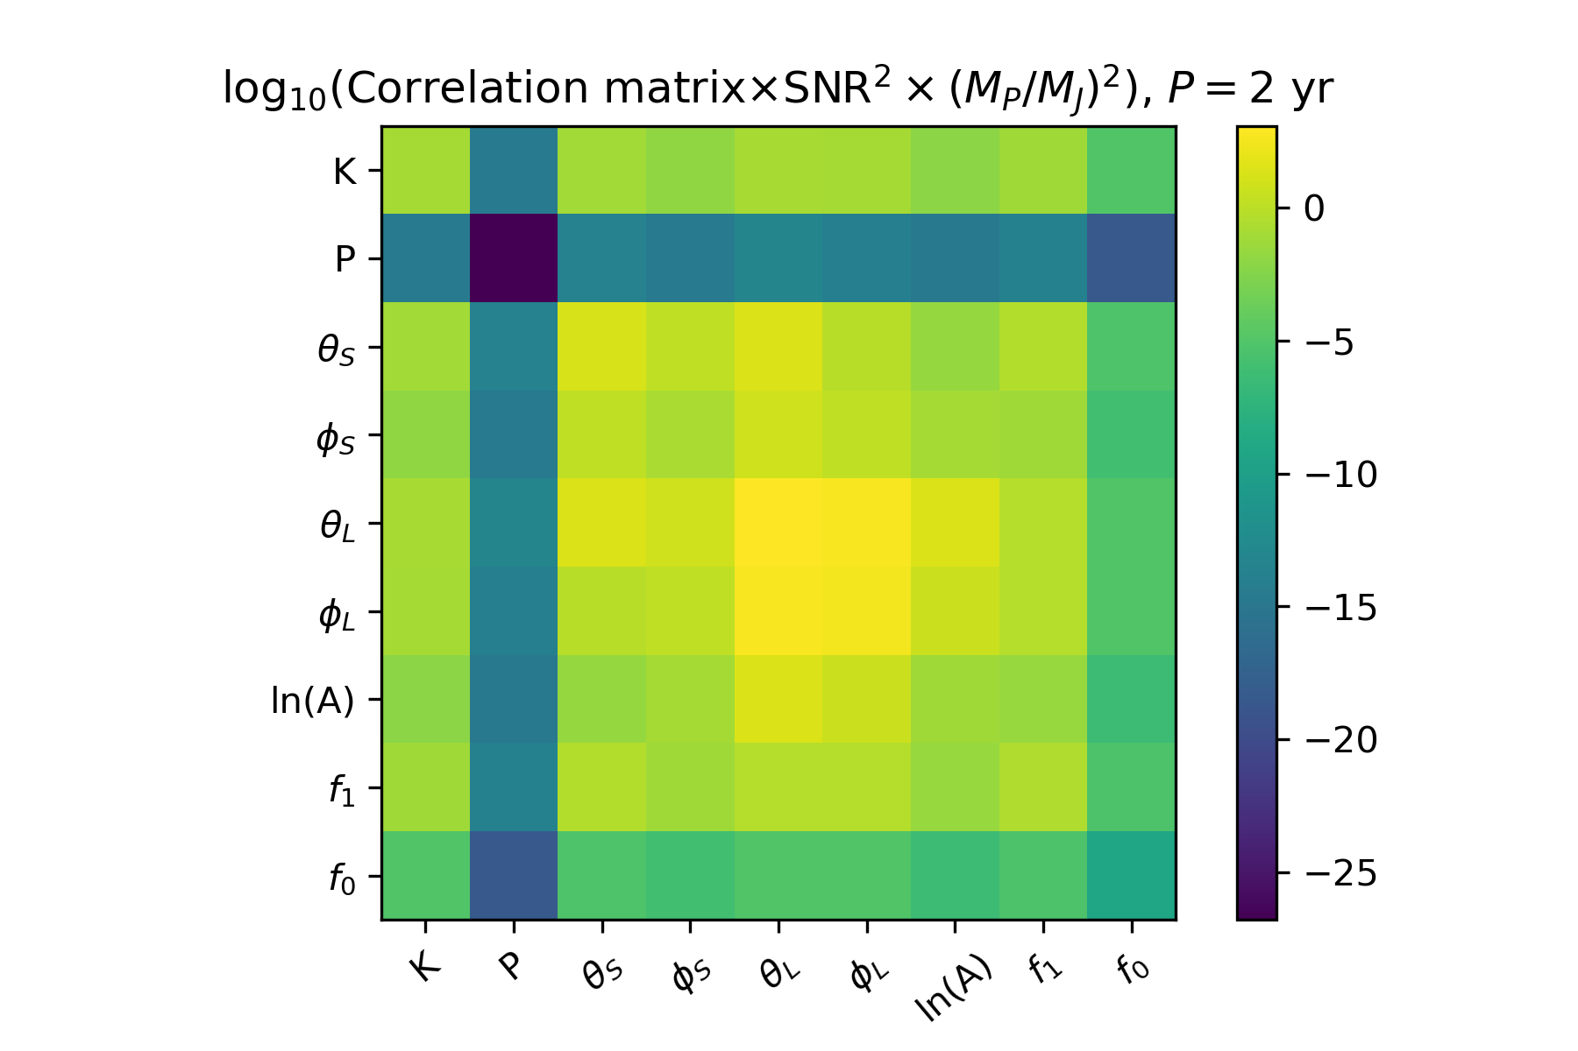
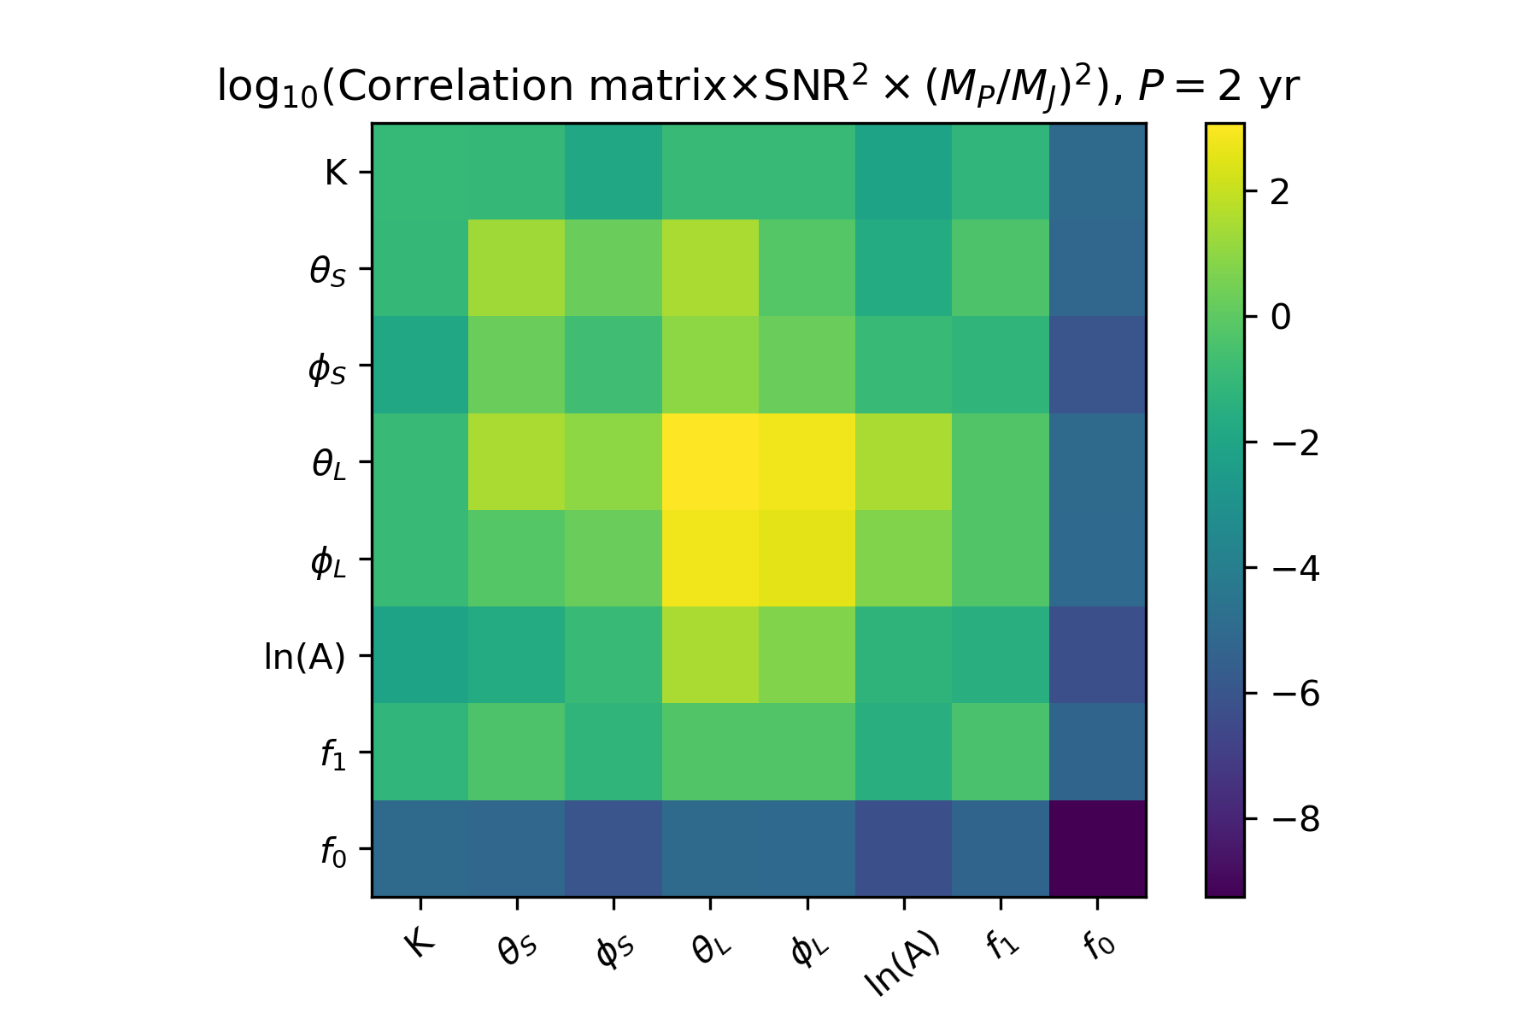
Correlation matrix for the whole parameter set
As you can see, the initial phase of the binary is completely undetermined in icegiant – qualitative explanation: only one arm measuring the change in amplitude: An exoplanet of P=10 yr coming around a f~10.1 mHz binary will produce the same strain as a P=10 yr binary going away from us at f~9.9 mHz

Slide 22
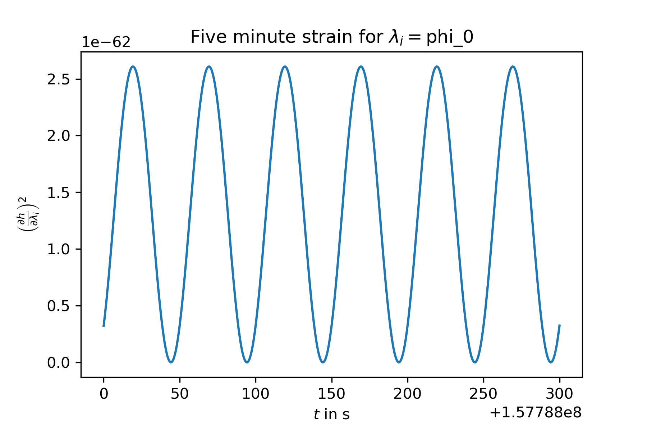
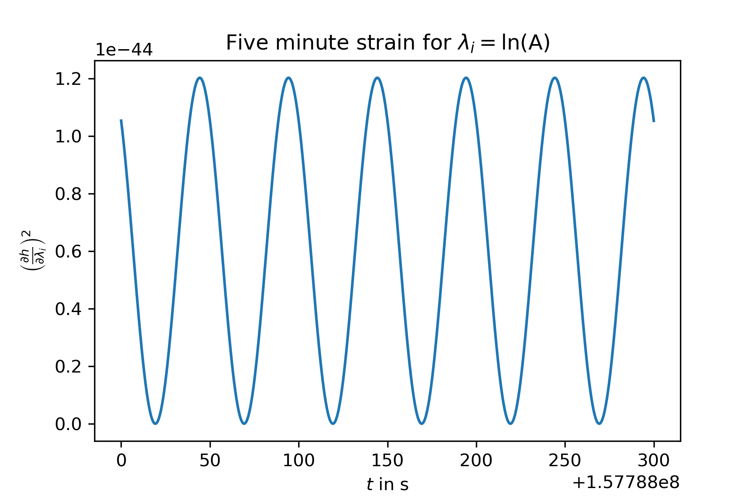
Correlation matrix for the whole parameter set
Alternative quantitative explanation: $\frac{∂f}{∂φ_{0}}=f\left(t\right)\frac{K}{c}sin\left(\frac{2πt}{P}+φ_{0}\right)\sim O\left({10}^{−3}×{10}^{−7}\right),$ so $\frac{∂h}{∂φ_{0}}\sim O({10}^{−10}×h)$ and therefore ${\left(\frac{∂h}{∂φ_{0}}\frac{∂h}{∂φ_{0}}\right)}^{−1}\sim O({10}^{20}×h^{2})$ -> undetermined $φ_{0}$

Slide 23
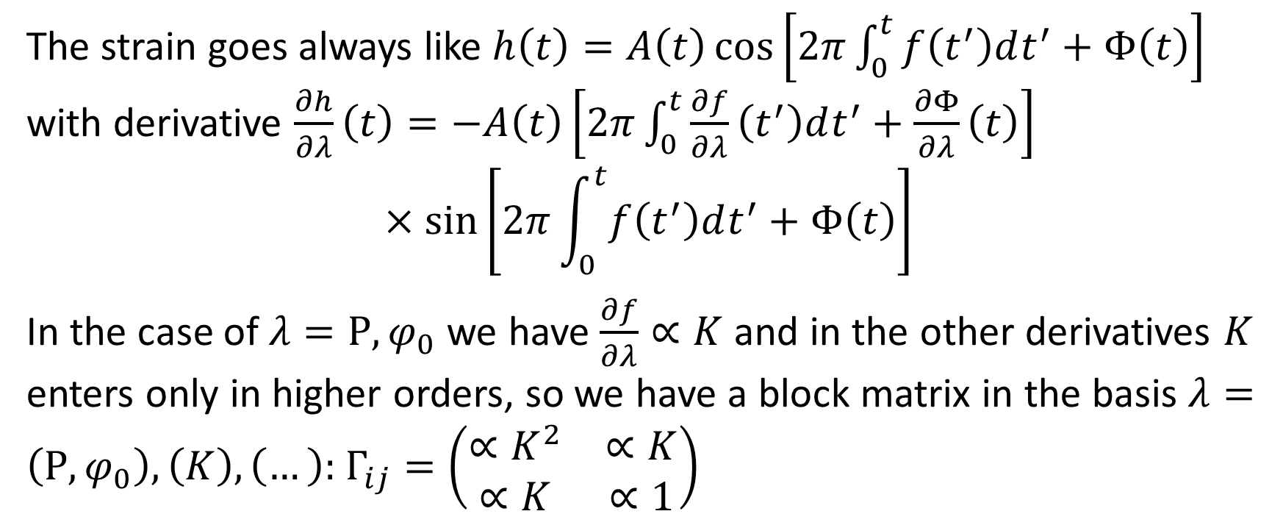

Short proof for the linearity of the exoplanet relative uncertainties in $K^{−1}$
The strain goes always like $h\left(t\right)=A\left(t\right)\cos\left[2π\int_{0}^{t}{f\left(t^{′}\right)dt^{′}}+Φ\left(t\right)\right]$ with derivative $\frac{∂h}{∂λ}\left(t\right)=−A\left(t\right)\left[2π\int_{0}^{t}{\frac{∂f}{∂λ}\left(t^{′}\right)dt^{′}}+\frac{∂Φ}{∂λ}\left(t\right)\right]$
$$×\sin\left[2π\int_{0}^{t}{f\left(t^{′}\right)dt^{′}}+Φ\left(t\right)\right]$$
In the case of $λ=P, φ_{0}$ we have $\frac{∂f}{∂λ}∝K$ and in the other derivatives $K$ enters only in higher orders, so we have a block matrix in the basis $λ=\left(P, φ_{0}\right), \left(K\right), \left(…\right):$ $Γ_{ij}=\left(\begin{matrix}∝K^{2} & ∝K \\ ∝K & ∝1\end{matrix}\right)$

Slide 24
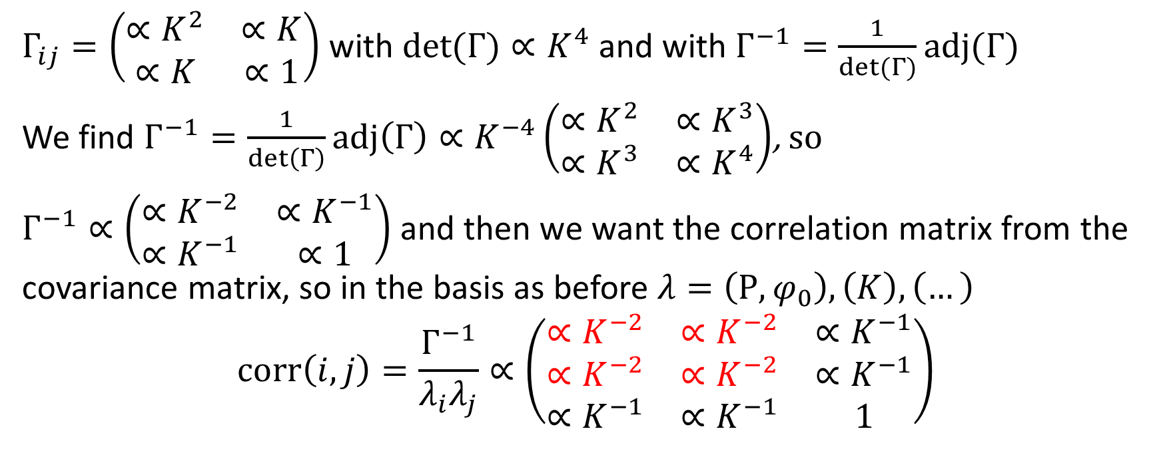
Short proof for the linearity of the exoplanet relative uncertainties in $K^{−1}$
$Γ_{ij}=\left(\begin{matrix}∝K^{2} & ∝K \\ ∝K & ∝1\end{matrix}\right)$ with $det(Γ)∝K^{4}$ and with $Γ^{−1}=\frac{1}{det(Γ)}adj(Γ)$
We find $Γ^{−1}=\frac{1}{\det\left(Γ\right)}adj\left(Γ\right)∝K^{−4}\left(\begin{matrix}∝K^{2} & ∝K^{3} \\ ∝K^{3} & ∝K^{4}\end{matrix}\right)$, so
$Γ^{−1}∝\left(\begin{matrix}∝K^{−2} & ∝K^{−1} \\ ∝K^{−1} & ∝1\end{matrix}\right)$ and then we want the correlation matrix from the covariance matrix, so in the basis as before $λ=\left(P, φ_{0}\right), \left(K\right), \left(…\right)$
$$corr\left(i,j\right)=\frac{Γ^{−1}}{λ_{i}λ_{j}}∝\left(\begin{matrix}∝K^{−2} & ∝K^{−2} & ∝K^{−1} \\ ∝K^{−2} & ∝K^{−2} & ∝K^{−1} \\ ∝K^{−1} & ∝K^{−1} & 1\end{matrix}\right)$$

Slide 25
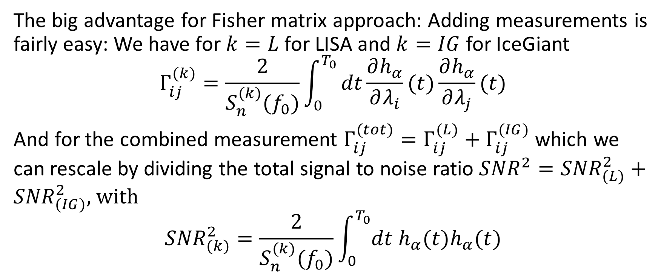
Combining measurements
The big advantage for Fisher matrix approach: Adding measurements is fairly easy: We have for $k=L$ for LISA and $k=IG$ for IceGiant
$$Γ_{ij}^{(k)}=\frac{2}{S_{n}^{(k)}(f_{0})}\int_{0}^{T_{0}}{dt\frac{∂h_{α}}{∂λ_{i}}(t)\frac{∂h_{α}}{∂λ_{j}}(t)}$$
And for the combined measurement $Γ_{ij}^{(tot)}=Γ_{ij}^{(L)}+Γ_{ij}^{(IG)}$ which we can rescale by dividing the total signal to noise ratio ${SNR}^{2}={SNR}_{(L)}^{2}+{SNR}_{(IG)}^{2},$ with
$${SNR}_{(k)}^{2}=\frac{2}{S_{n}^{(k)}(f_{0})}\int_{0}^{T_{0}}{dt h_{α}(t)h_{α}(t)}$$

Slide 26
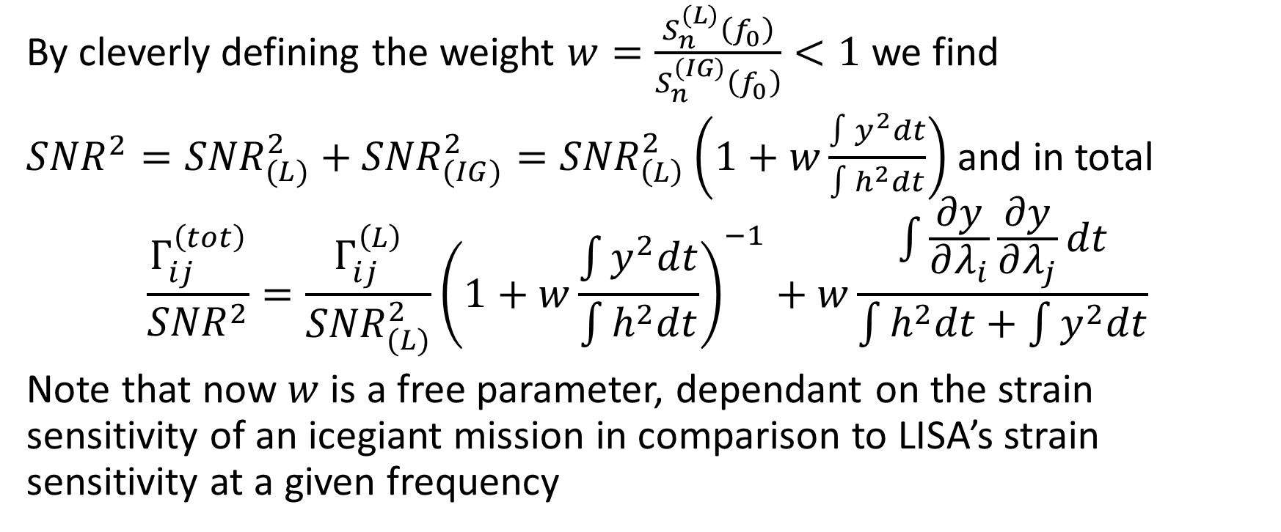
Combining measurements
By cleverly defining the weight $w=\frac{S_{n}^{\left(L\right)}\left(f_{0}\right)}{S_{n}^{\left(IG\right)}\left(f_{0}\right)}<1$ we find
${SNR}^{2}={SNR}_{(L)}^{2}+{SNR}_{(IG)}^{2}={SNR}_{\left(L\right)}^{2}\left(1+w\frac{\int{y^{2}dt}}{\int{h^{2}dt}}\right)$ and in total
$$\frac{Γ_{ij}^{\left(tot\right)}}{{SNR}^{2}}=\frac{Γ_{ij}^{\left(L\right)}}{{SNR}_{(L)}^{2}}{\left(1+w\frac{\int{y^{2}dt}}{\int{h^{2}dt}}\right)}^{−1}+w\frac{\int{\frac{∂y}{∂λ_{i}}\frac{∂y}{∂λ_{j}}}dt}{\int{h^{2}dt}+\int{y^{2}dt}}$$
Note that now $w$ is a free parameter, dependant on the strain sensitivity of an icegiant mission in comparison to LISA’s strain sensitivity at a given frequency

Slide 27
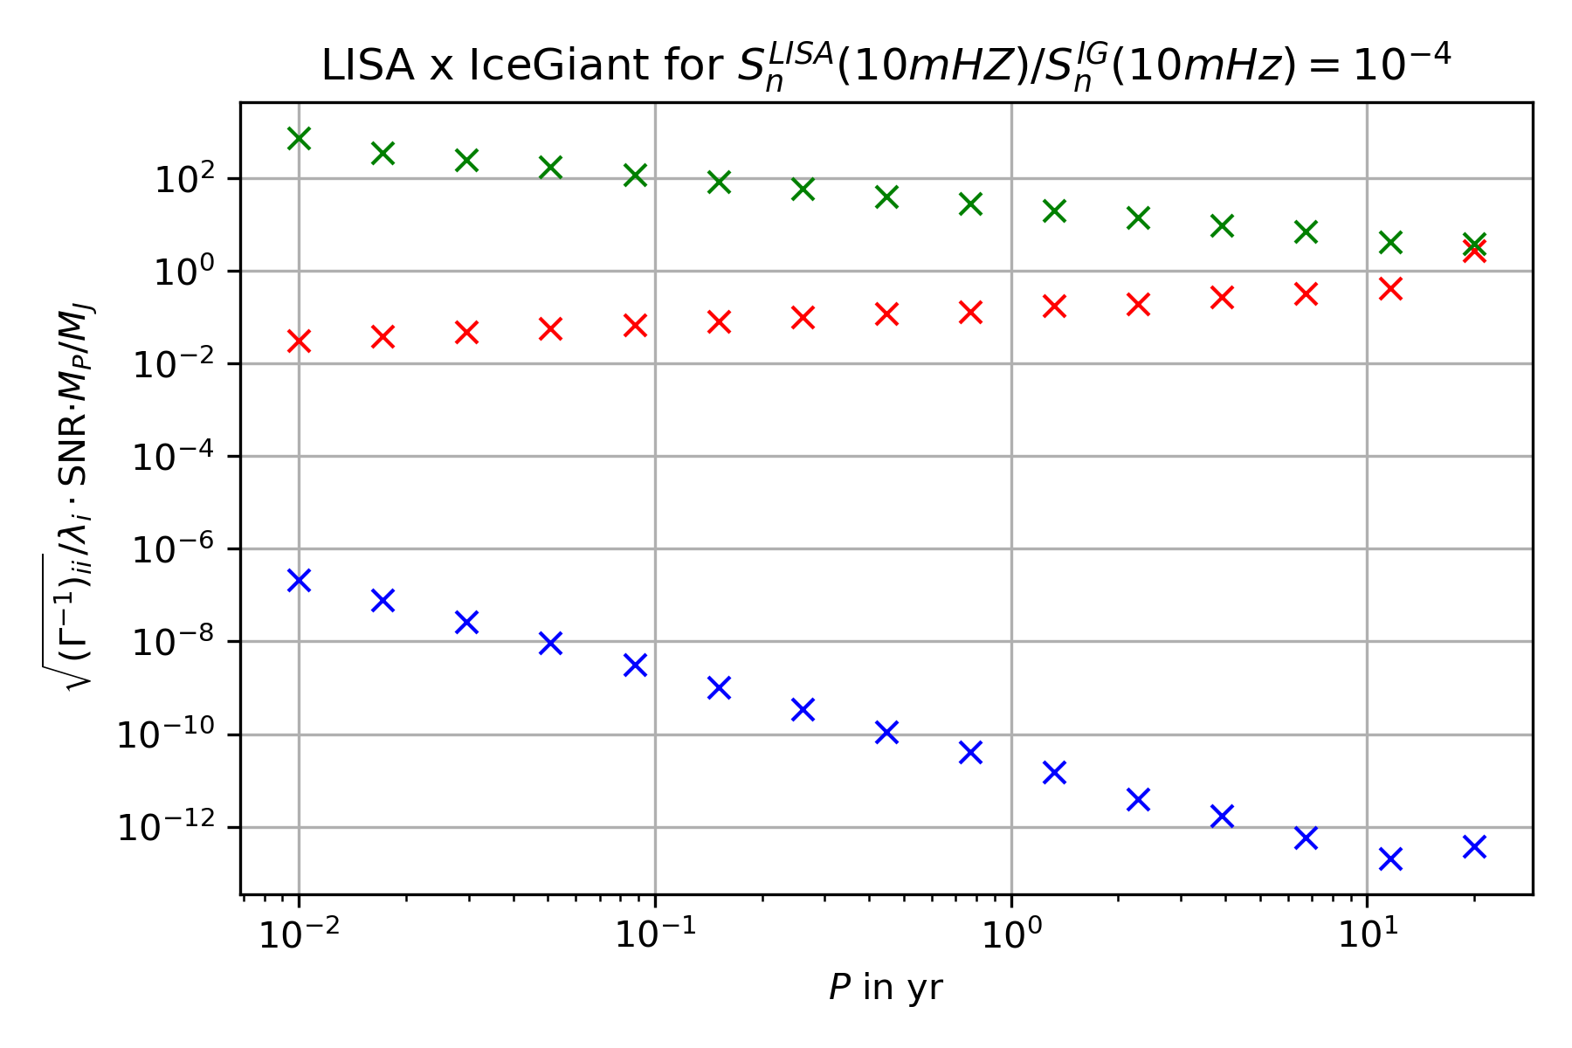
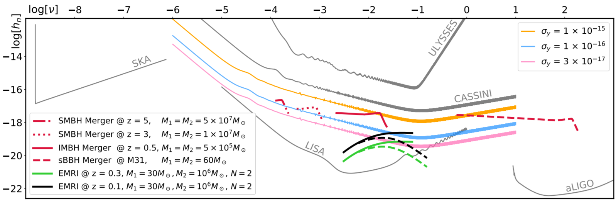
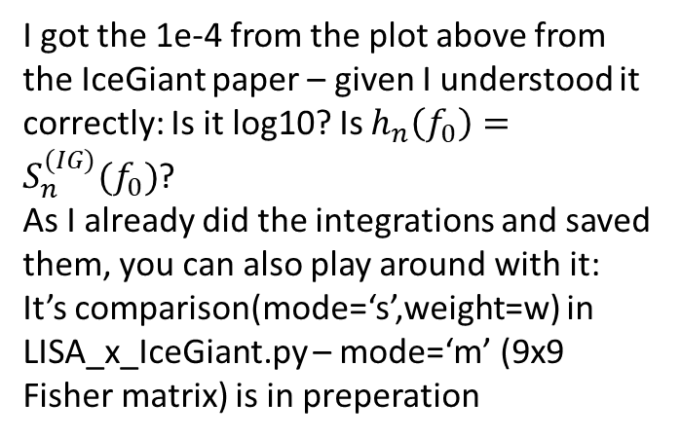
First combination
I got the 1e-4 from the plot above from the IceGiant paper – given I understood it correctly: Is it log10? Is $h_{n}\left(f_{0}\right)=S_{n}^{(IG)}(f_{0})$?
As I already did the integrations and saved them, you can also play around with it: It’s comparison(mode=‘s’,weight=w) in LISA_x_IceGiant.py – mode=‘m’ (9x9 Fisher matrix) is in preperation

Slide 28
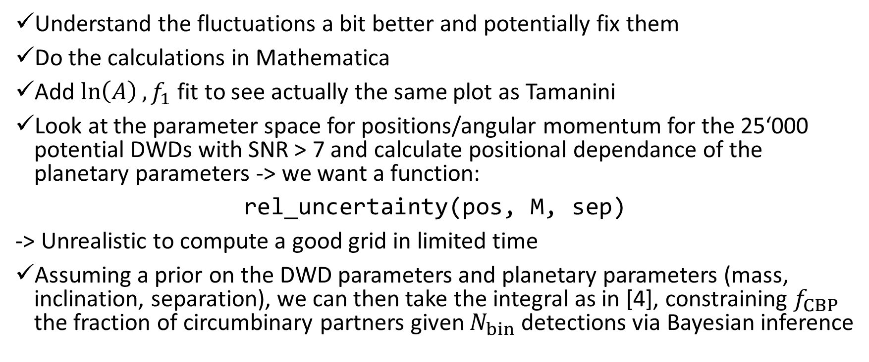
Next milestones
Understand the fluctuations a bit better and potentially fix them
Do the calculations in Mathematica
Add $\ln\left(A\right), f_{1}$ fit to see actually the same plot as Tamanini
Look at the parameter space for positions/angular momentum for the 25‘000 potential DWDs with SNR > 7 and calculate positional dependance of the planetary parameters -> we want a function:
rel_uncertainty(pos, M, sep)
-> Unrealistic to compute a good grid in limited time
Assuming a prior on the DWD parameters and planetary parameters (mass, inclination, separation), we can then take the integral as in [4], constraining $f_{CBP}$ the fraction of circumbinary partners given $N_{bin}$ detections via Bayesian inference

Slide 29
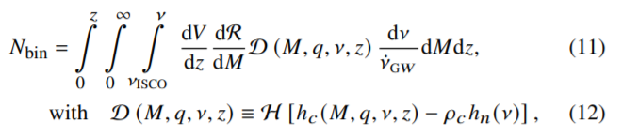
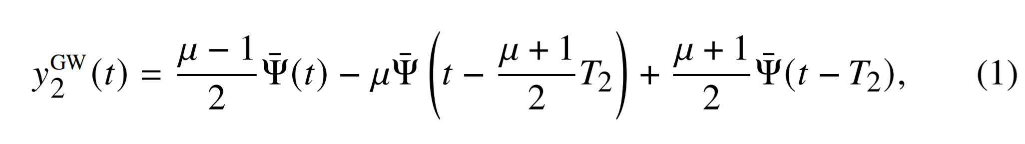
Next milestones
-> already done by Danielsky et al. [2]
Then repeat the exercise with the strain and signal to noise of the IceGiant mission: to see if it could see most promising exoplanet candidates/Jupiter-like planets
Combine measurements of IceGiant and LISA -> just add Fisher information prior to inversion ☺
Look for extragalactic X-Ray binaries and constrain the number of exoplanets/stars in orbit around them

Slide 30
References
[1] Tamanini, N., Danielski, C. (2019). The gravitational-wave detection of exoplanets orbiting white dwarf binaries using LISA. Nat Astron 3, 858–866. https://doi.org/10.1038/s41550-019-0807-y
[2] Danielski, C., Korol, V., Tamanini, N., & Rossi, E.M. (2019). Circumbinary exoplanets and brown dwarfs with the Laser Interferometer Space Antenna. Astronomy and Astrophysics, 632.
[3] Cutler, C. (1998). Angular resolution of the LISA gravitational wave detector. Physical Review D, 57, 7089-7102.
[4] Soyuer, D., Zwick, L., D’Orazio, D., Saha, P. (2021). Searching for gravitational waves via Doppler tracking by future missions to Uranus and Neptune. MNRAS: Letters, 503, 1, L73-79. https://doi.org/10.1093/mnrasl/slab025
[5] Maggiore, M. (2008). Gravitational Waves Volume 1: Theory and Experiments. Oxford University Press

